Slide 1
Sample Pipeline
Azure Blob Storage → Azure Data Factory → Azure SQL Database

Slide 2
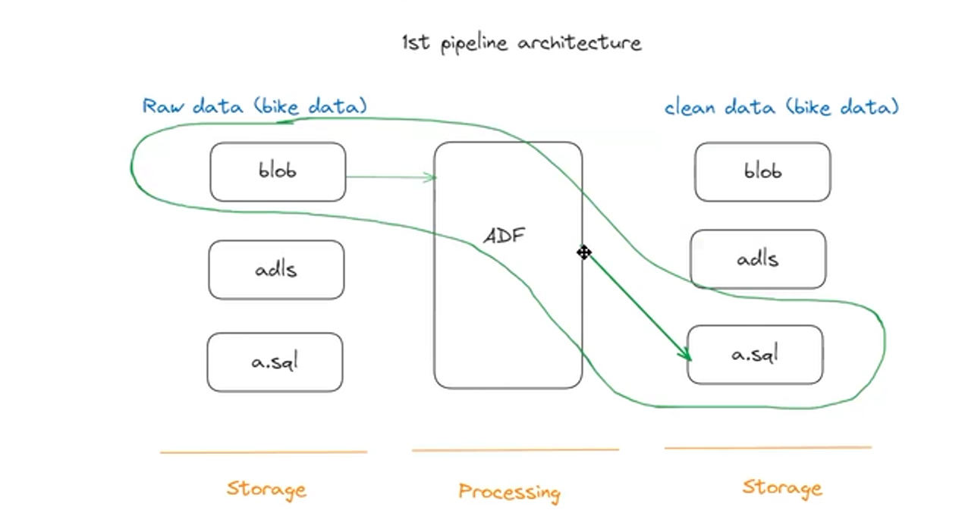
Architecture

Slide 3
Steps
First Create
AZURE BLOB STUDIO
AZURE DATA FACTORY
AZURE SQL DATABASE

Slide 4
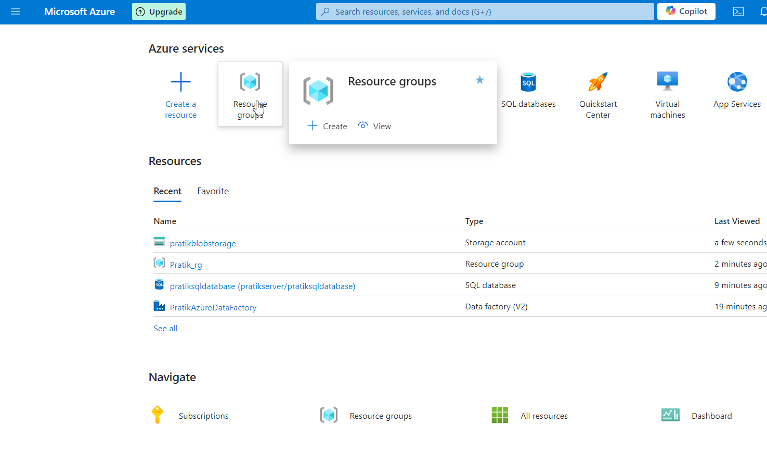
Go to Resource Group :

Slide 5
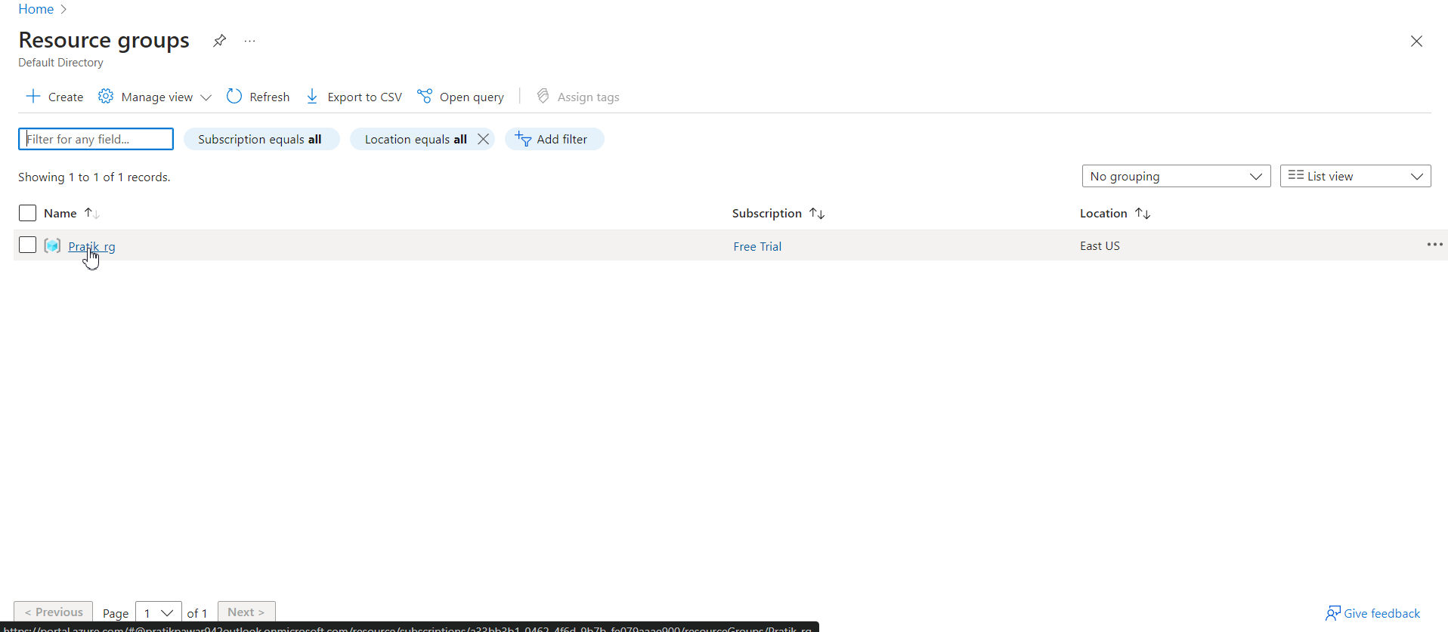
Select Resource Group Required :

Slide 6
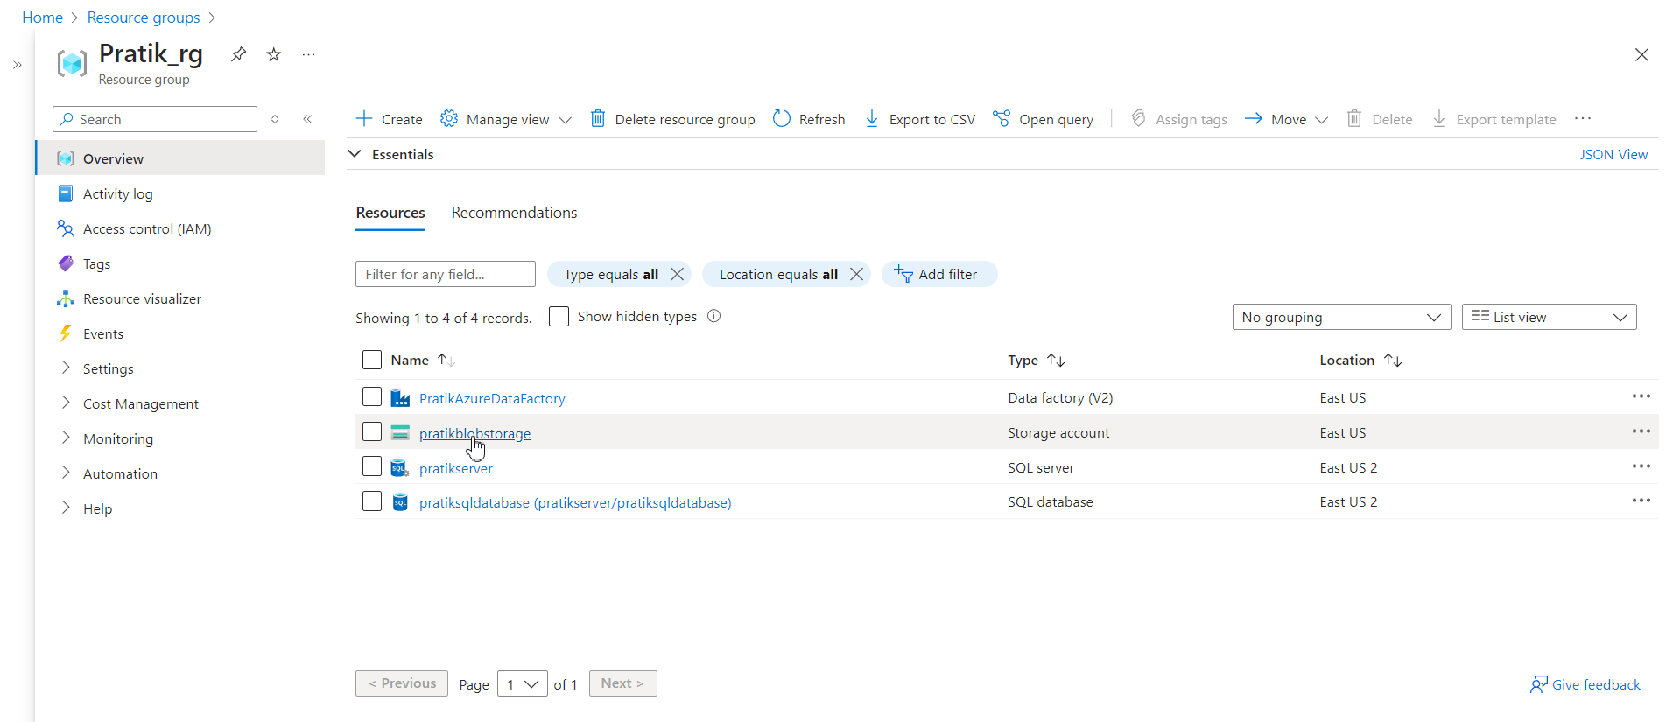
Select blob Storage to Upload Raw Data:

Slide 7
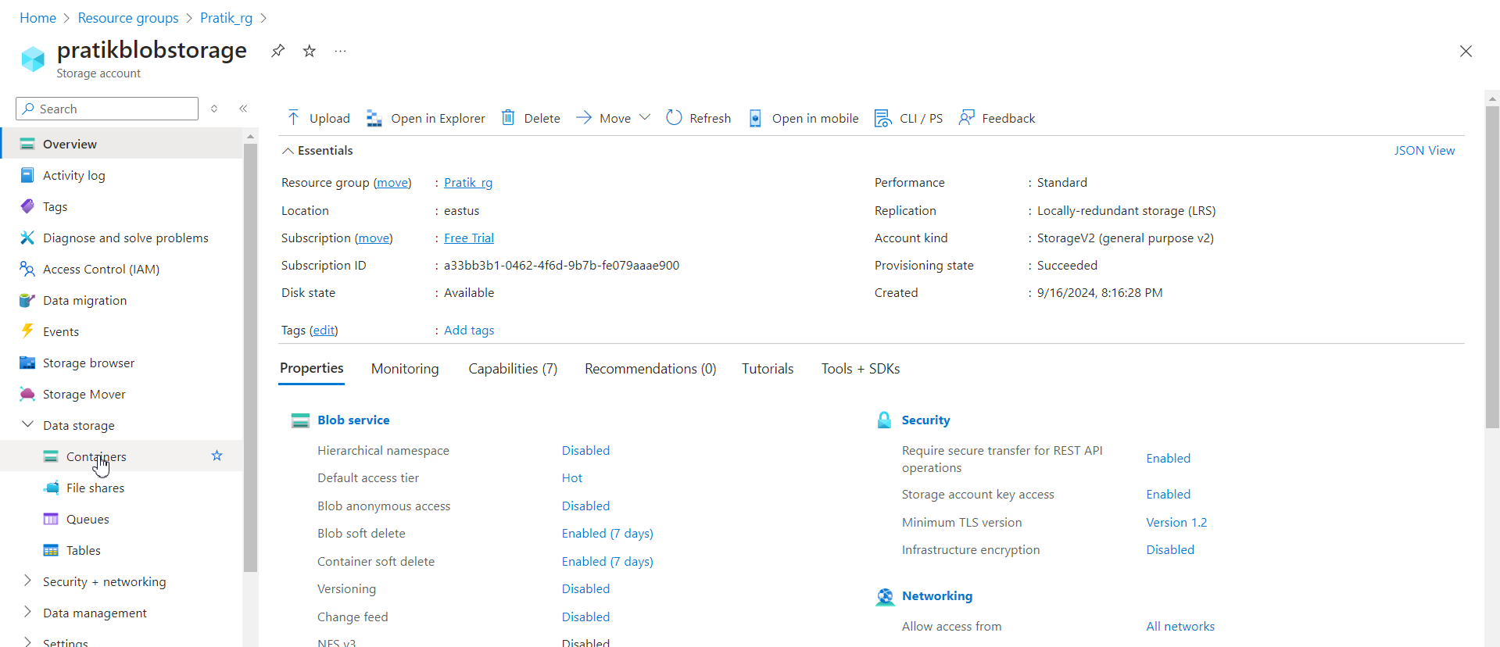
Go to Containers

Slide 8
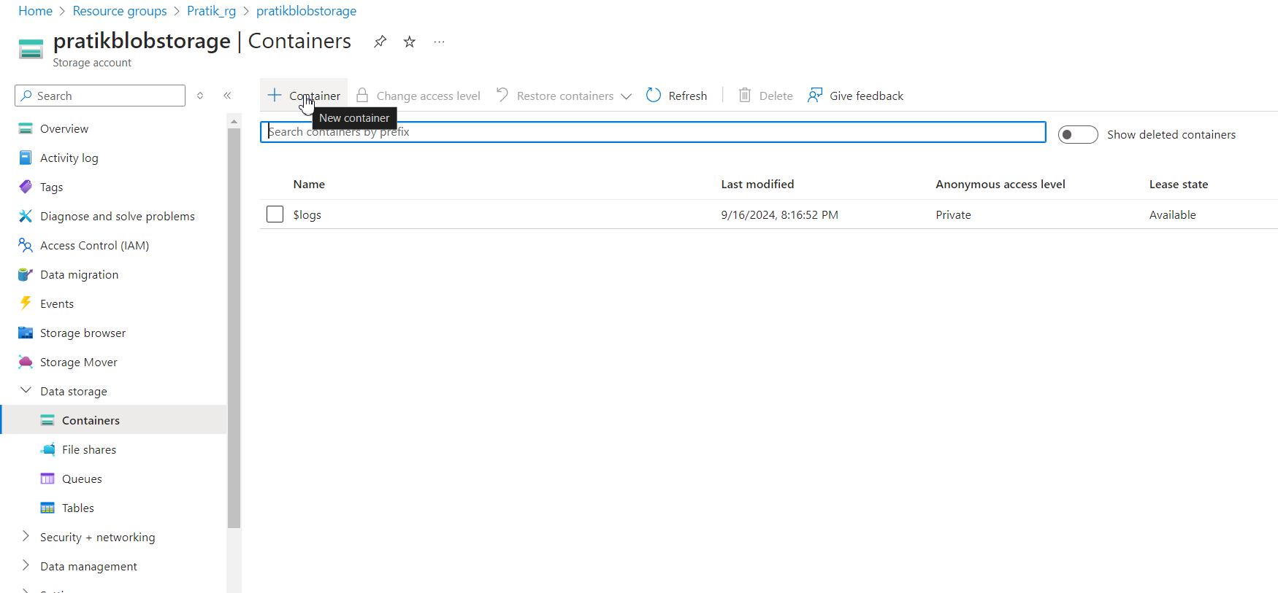
Create New Container

Slide 9
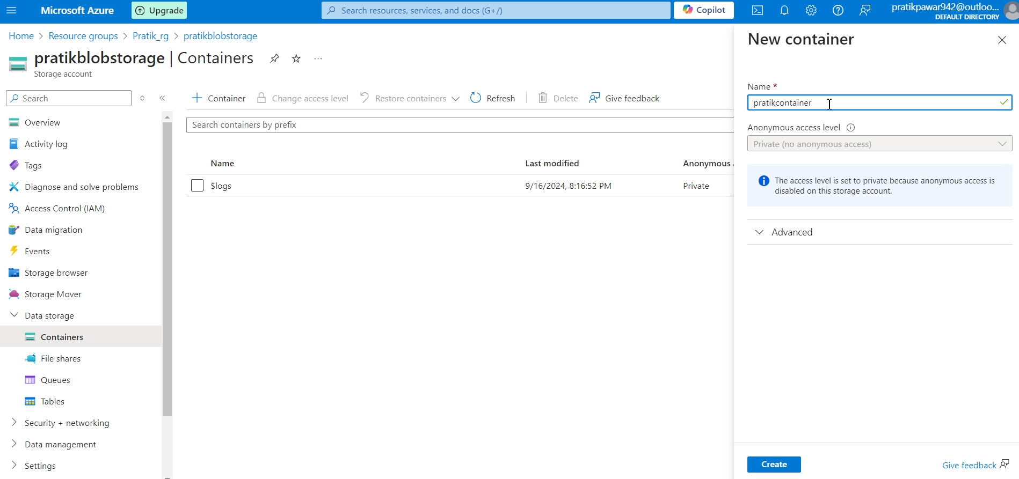
Give Name and Create:

Slide 10
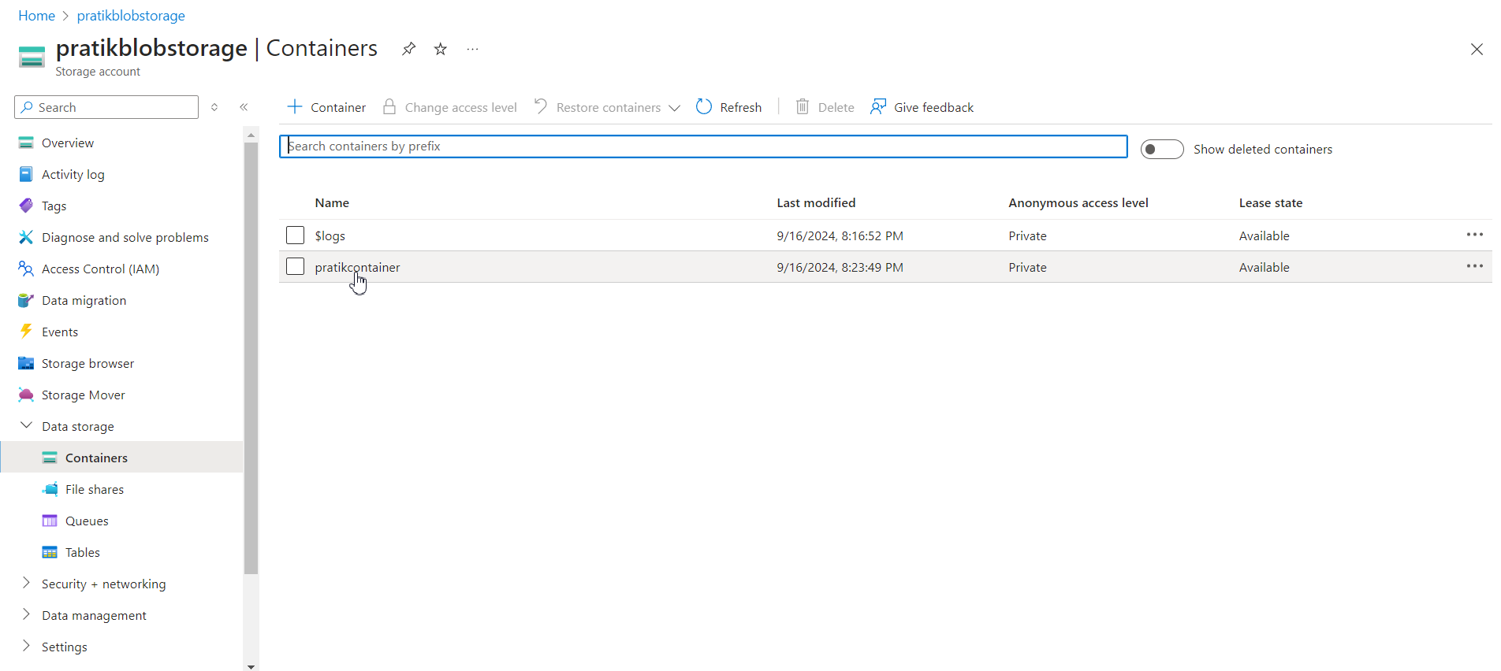
Select Container:

Slide 11
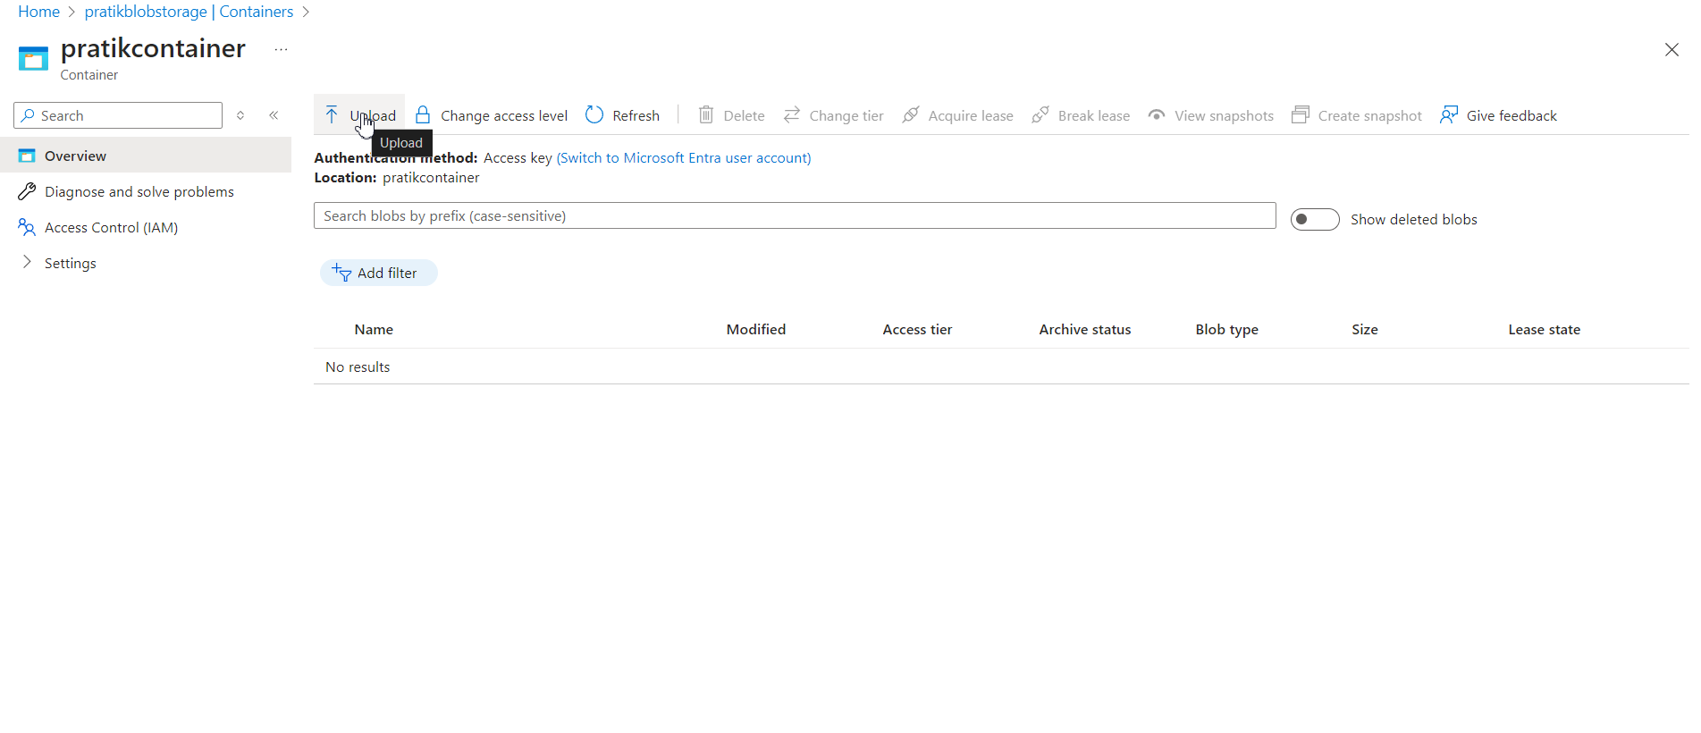
Upload:

Slide 12
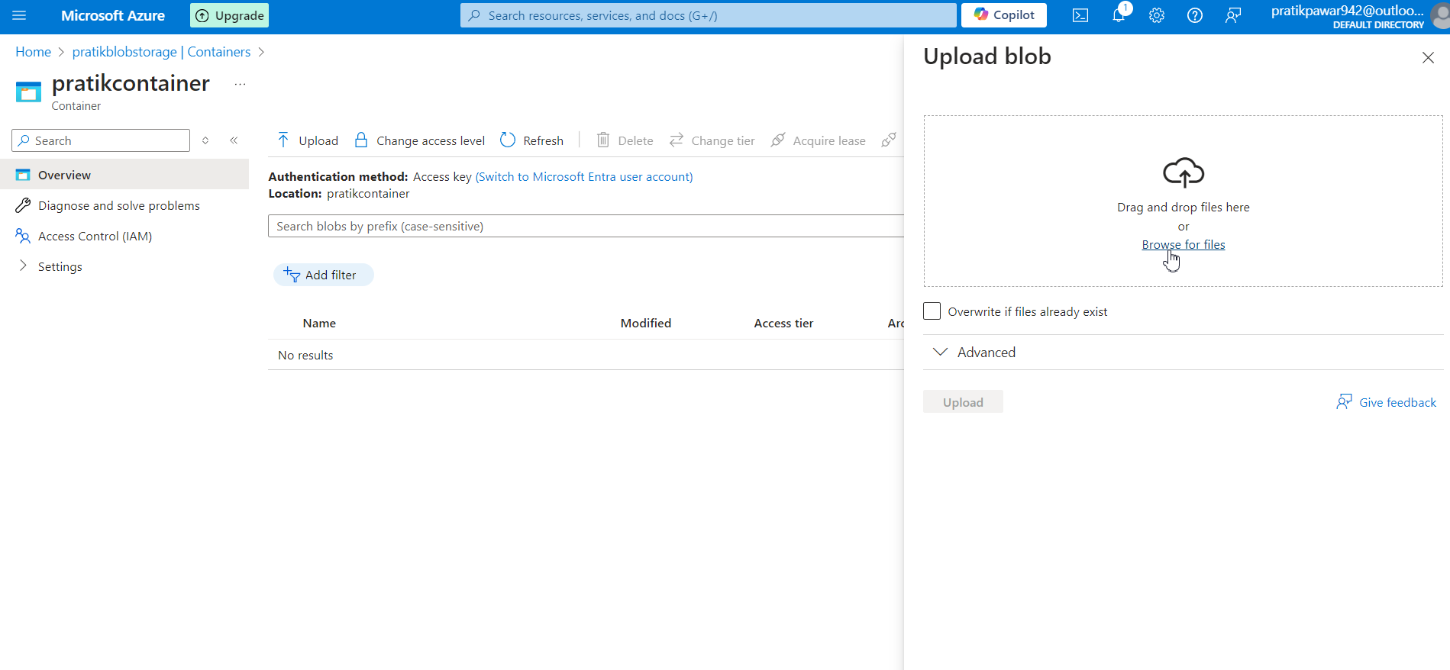
Upload Required Raw Data

Slide 13
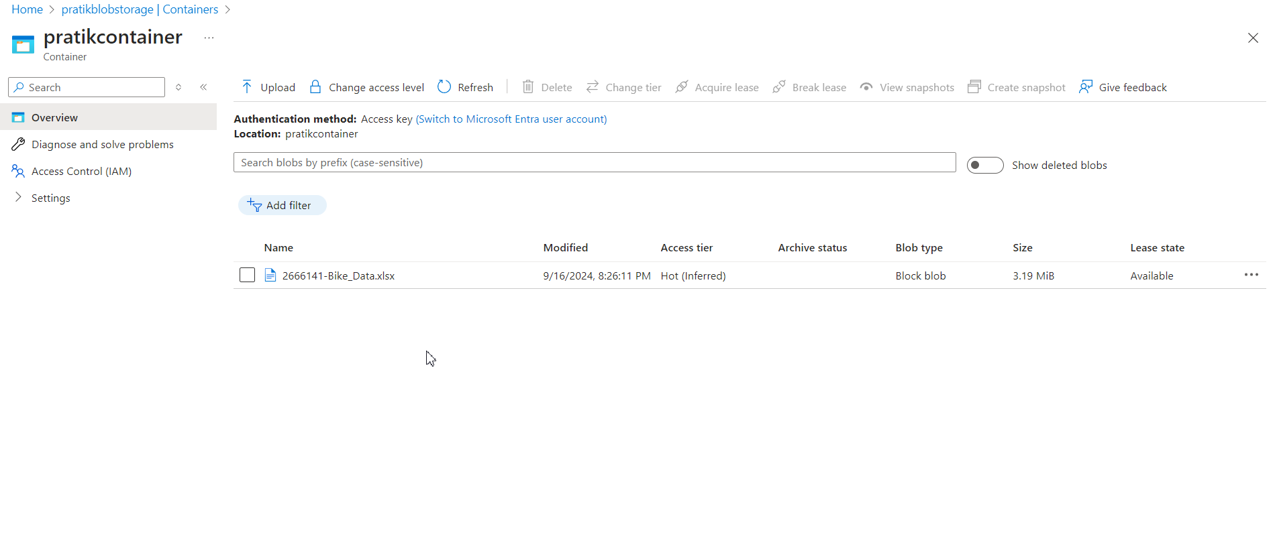
Data is Uploaded (data upload is handled by another team):

Slide 14
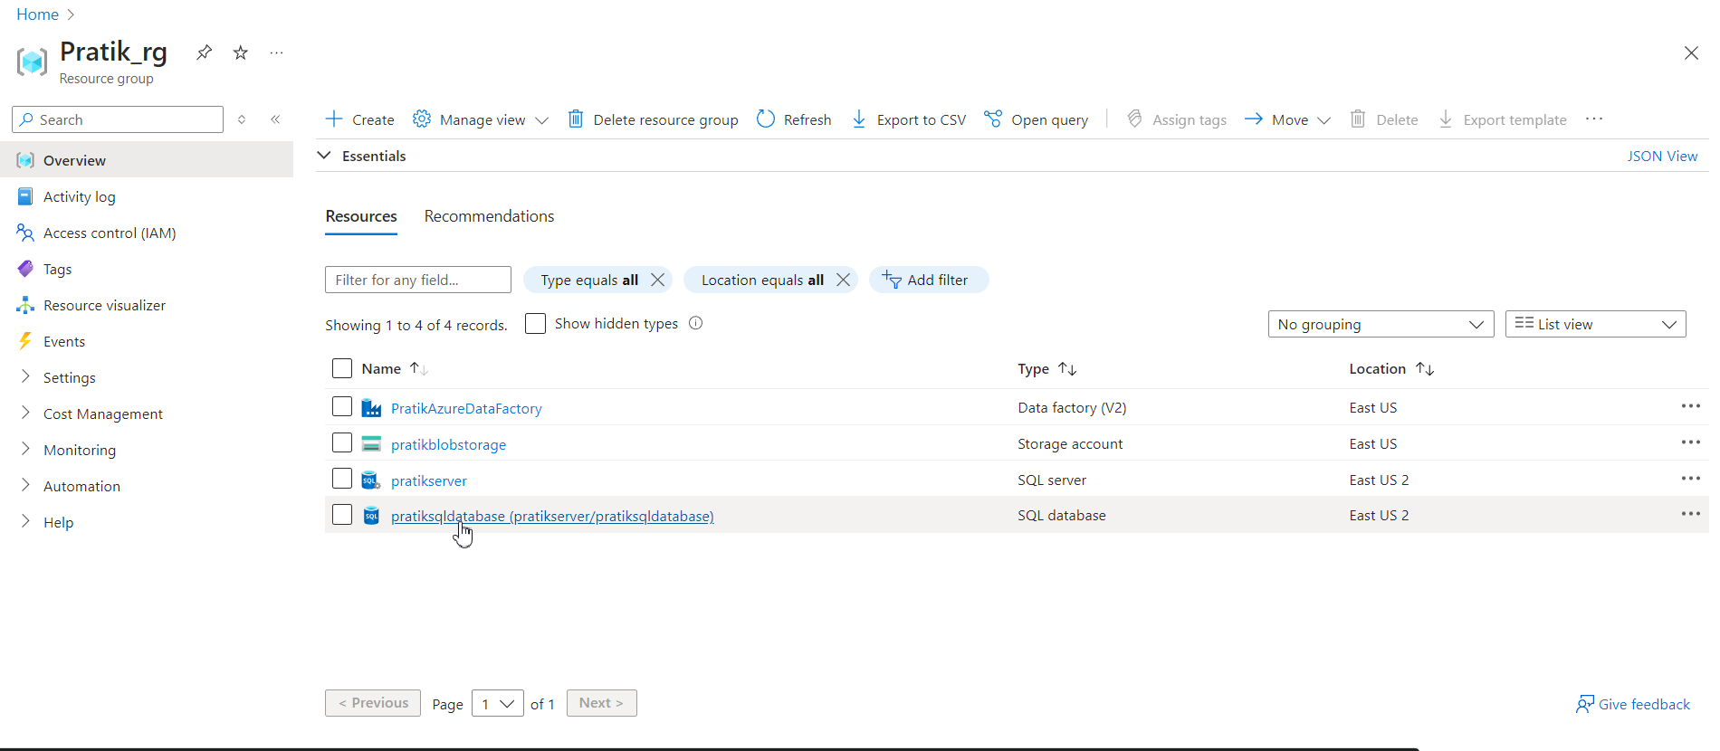
Now go to SQL Database:

Slide 15
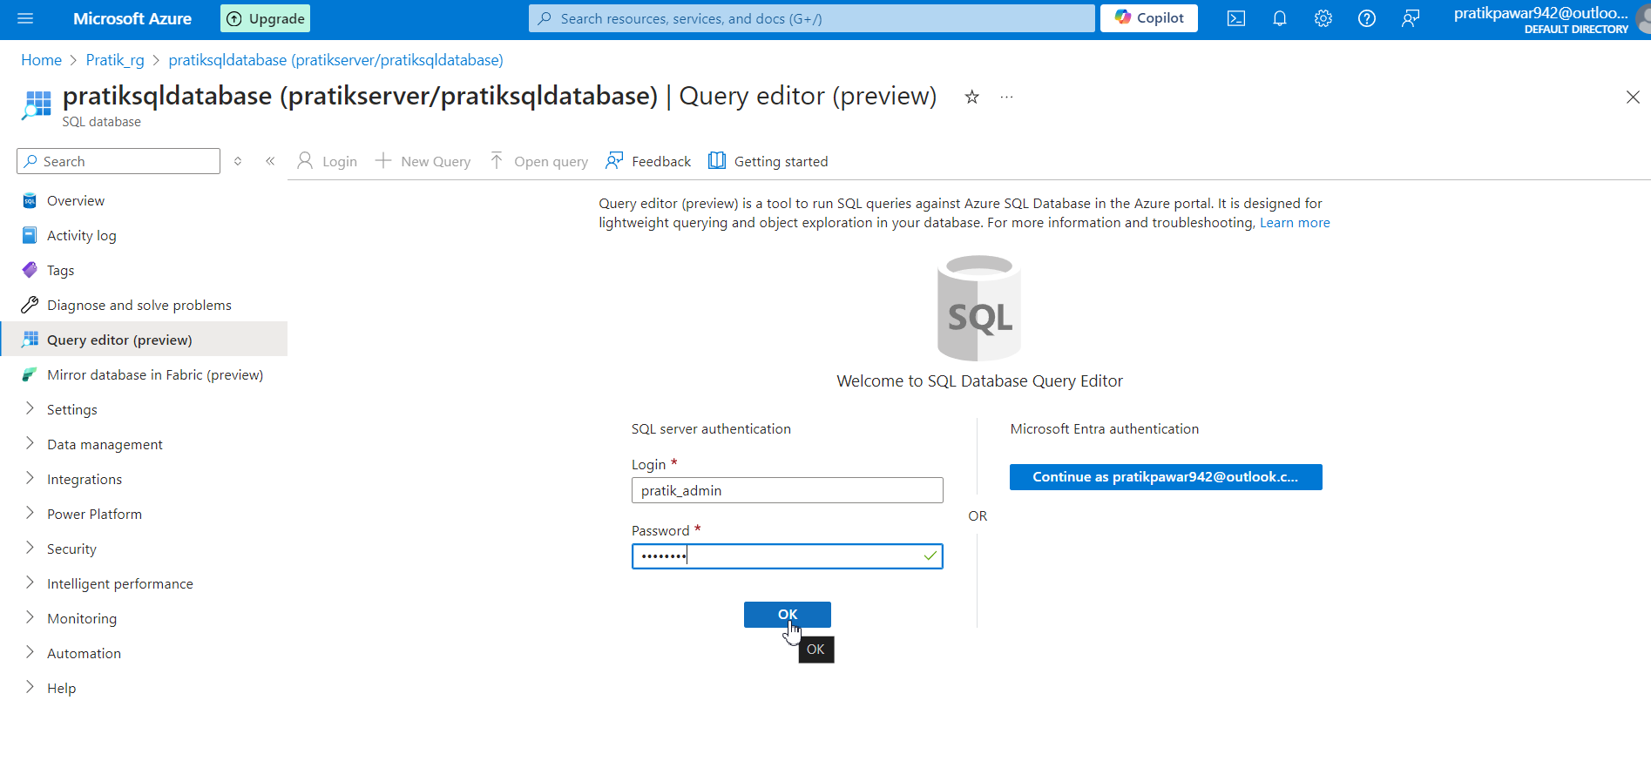
Go to Query Editor and Login SQL Server:

Slide 16
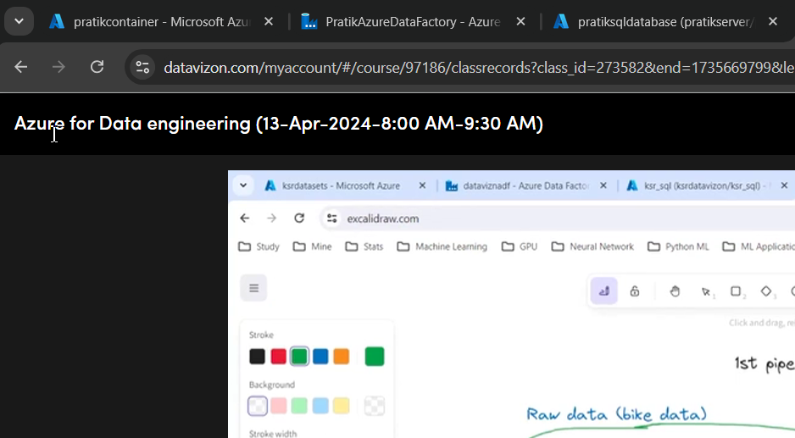
Arrange tabs according to Architecture:

Slide 17
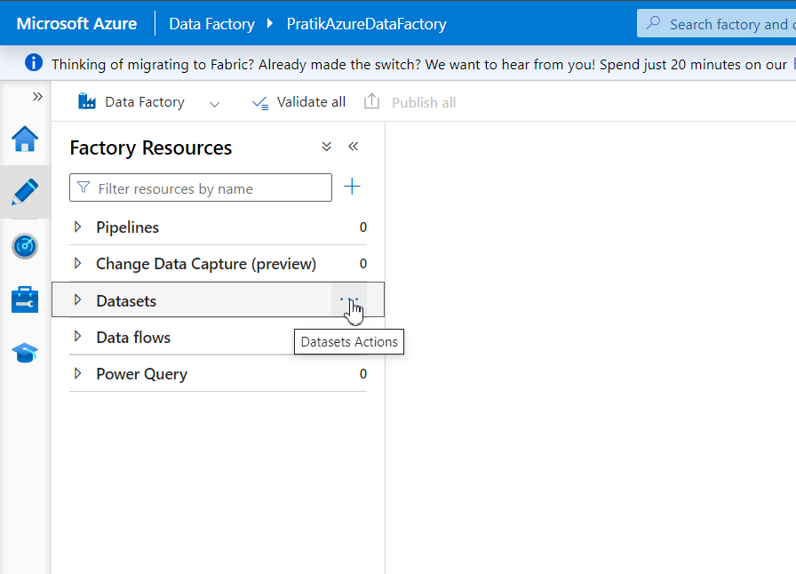
Datasets → Three Dots:

Slide 18
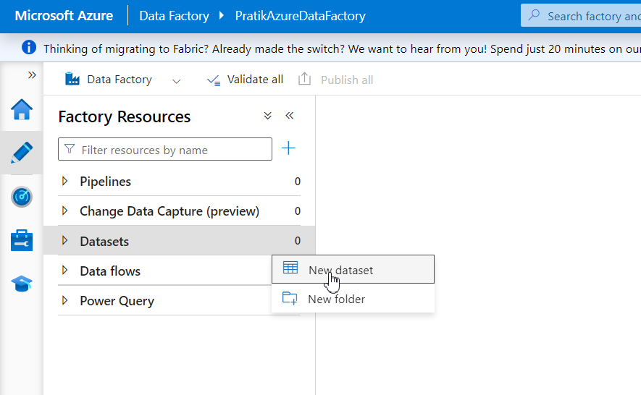
New Dataset:

Slide 19
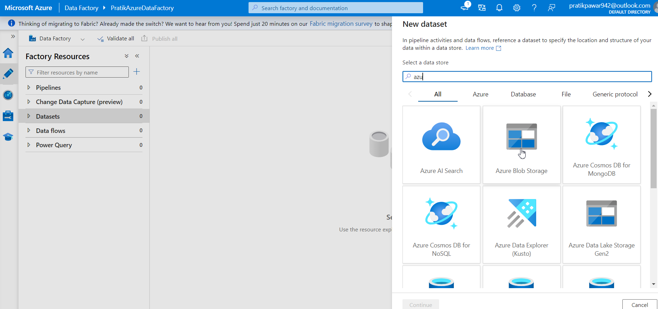
Select Azure Blob Storage (It depends from which LINKED Service raw data is coming)

Slide 20
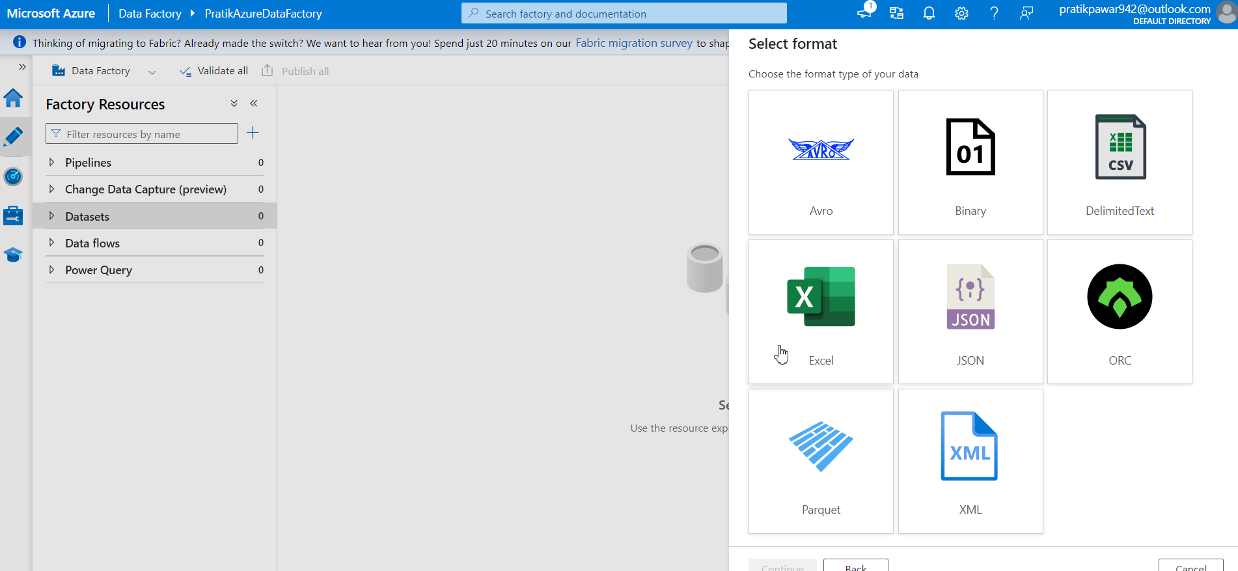
Select Data Format (Ours excel for now) → Continue

Slide 21
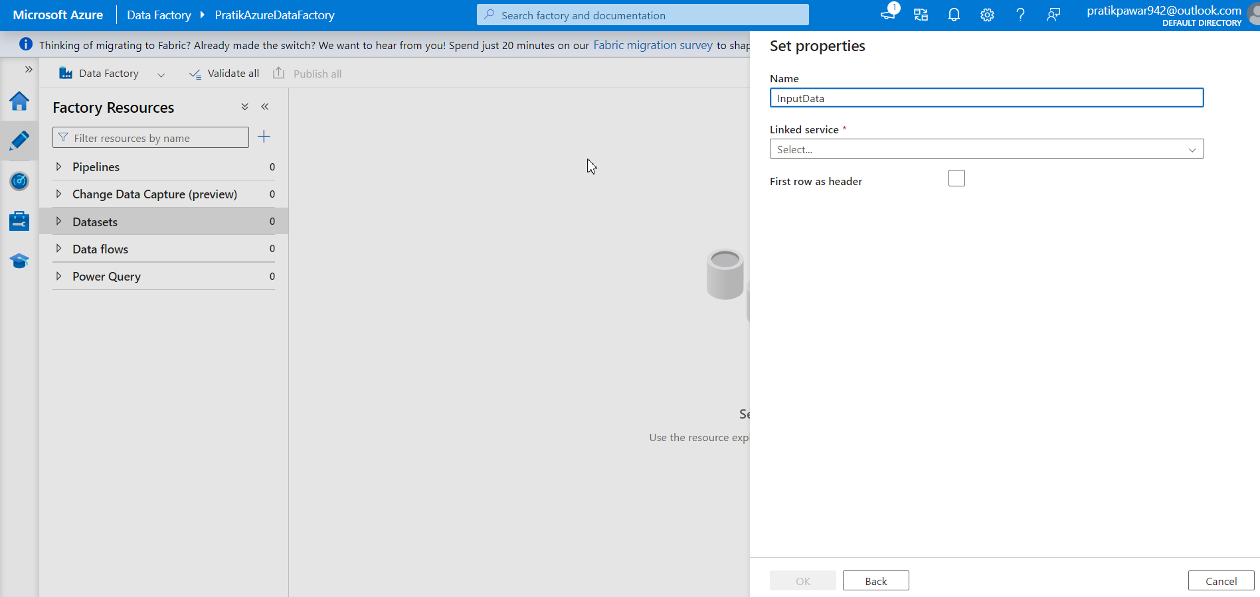
Name to Raw Data which are going to Import (Raw data is stored temporary in ADF)

Slide 22
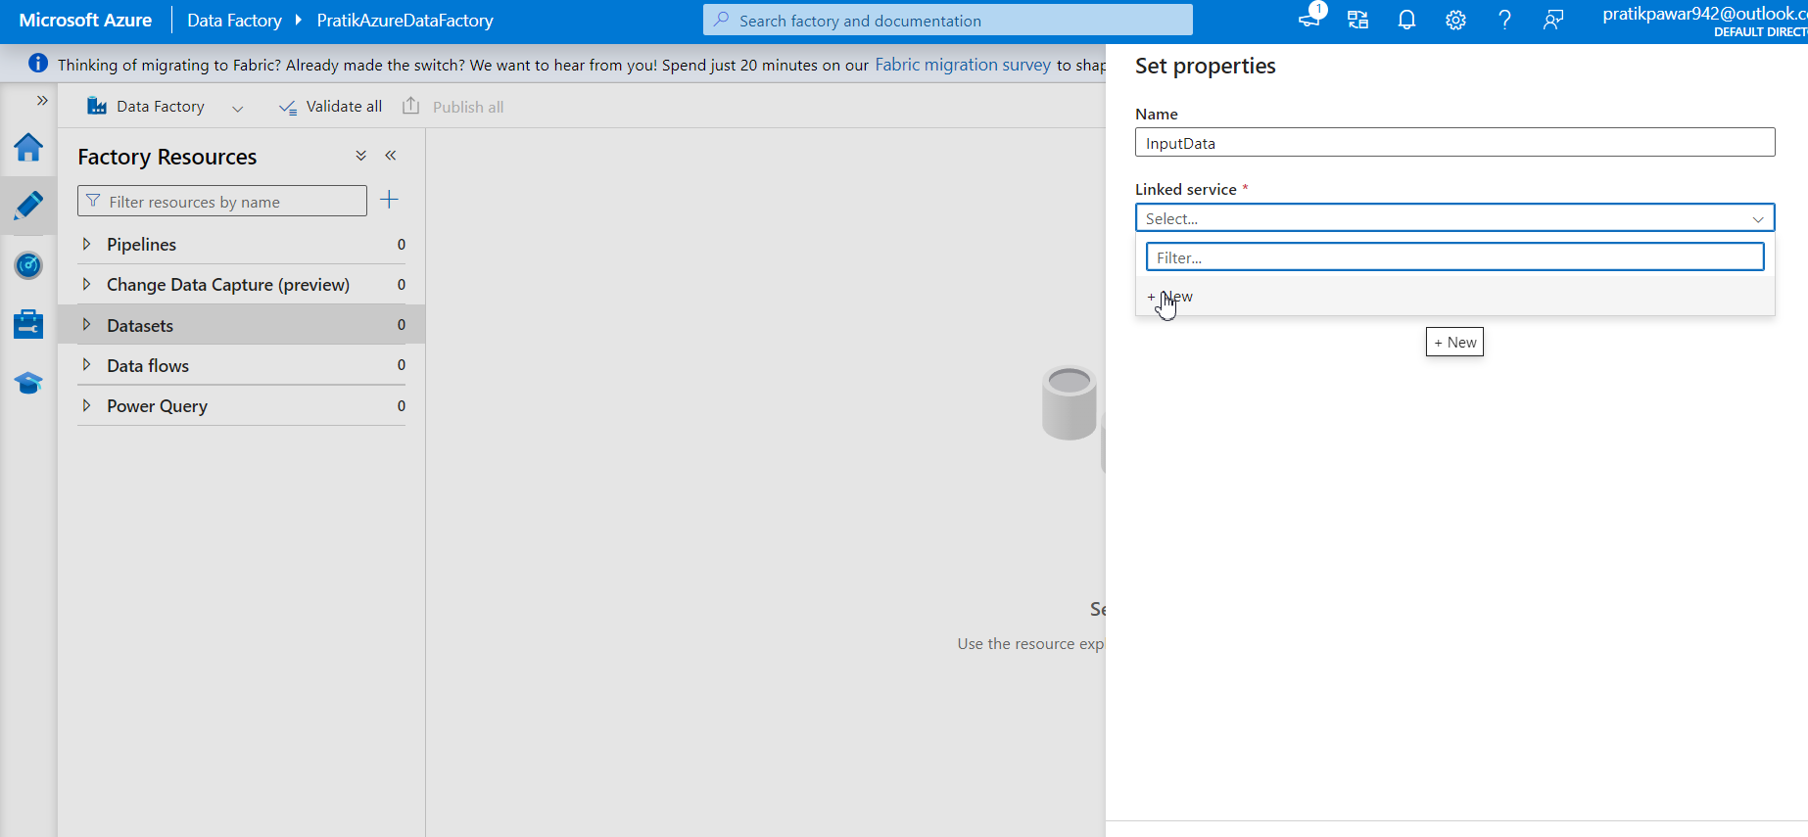
Add New linked Service to ADF as ADF is fresh

Slide 23
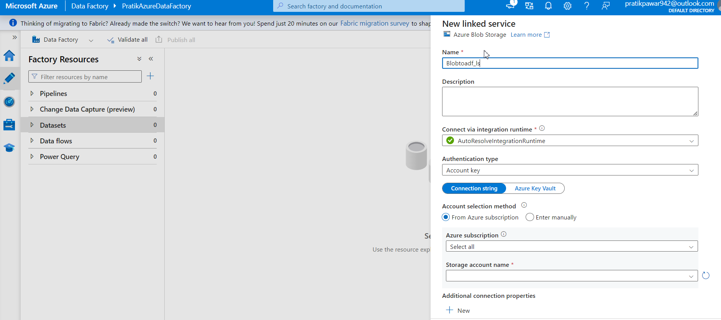
Name (BlobtoADF_ls) ls → Linked Service

Slide 24
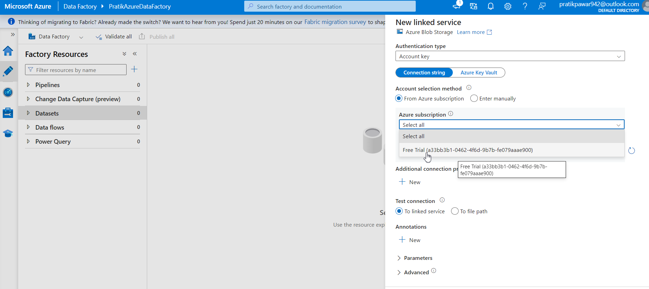
Select Our Current Subscription:

Slide 25
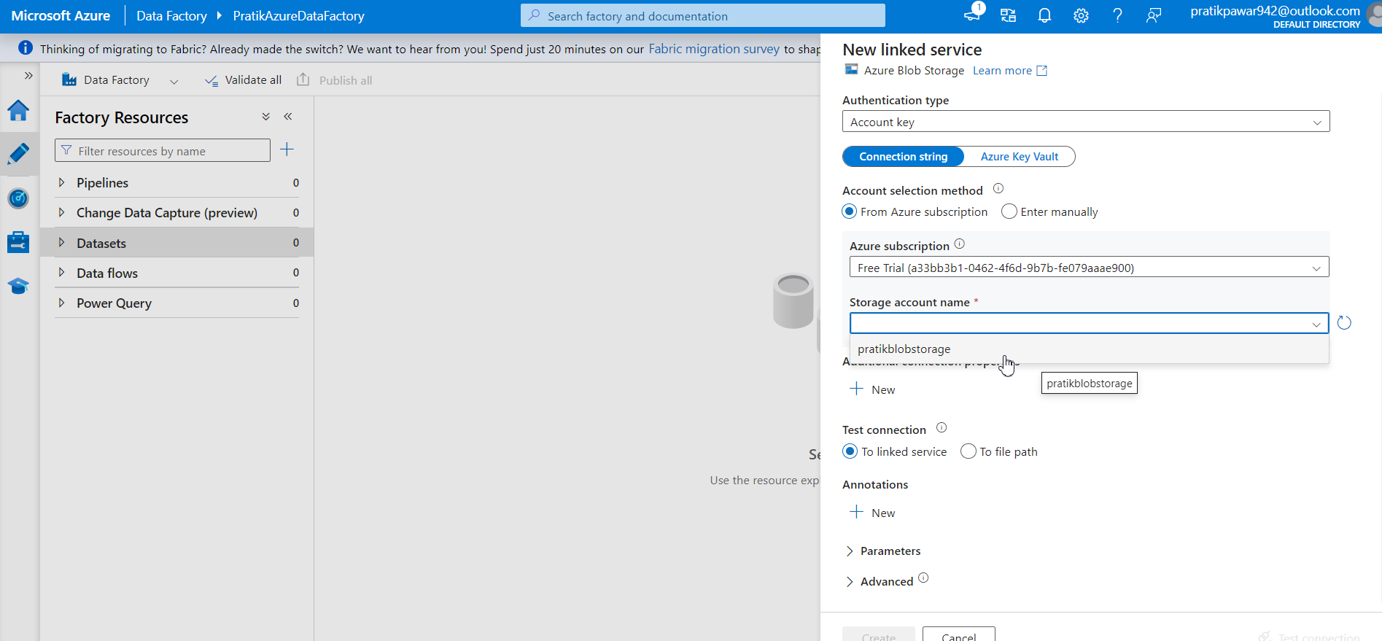
Select Storage Account Name ( Pratikblobstorage)

Slide 26
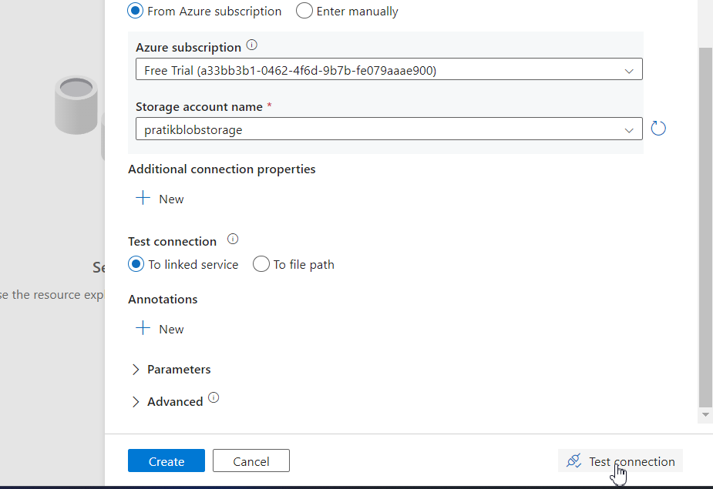
Now Test Connection and Create

Slide 27
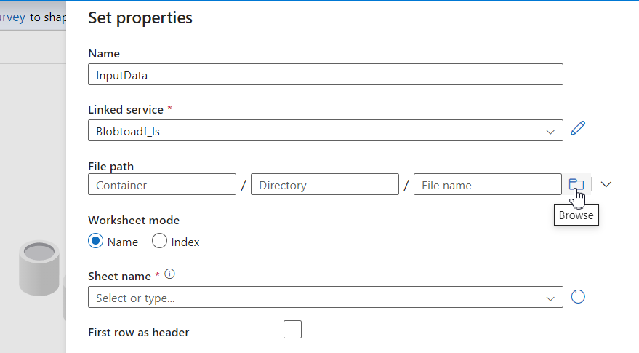
Browse( Selecting path of Raw Data)

Slide 28
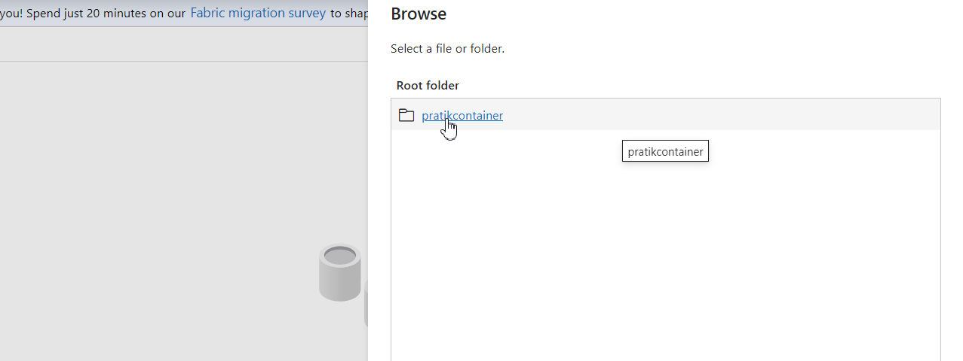
Select Container

Slide 29
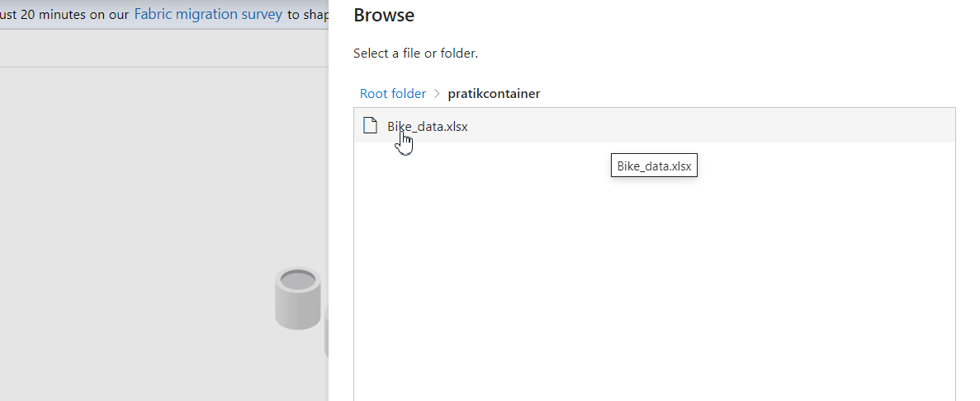
Select Required file from Container

Slide 30
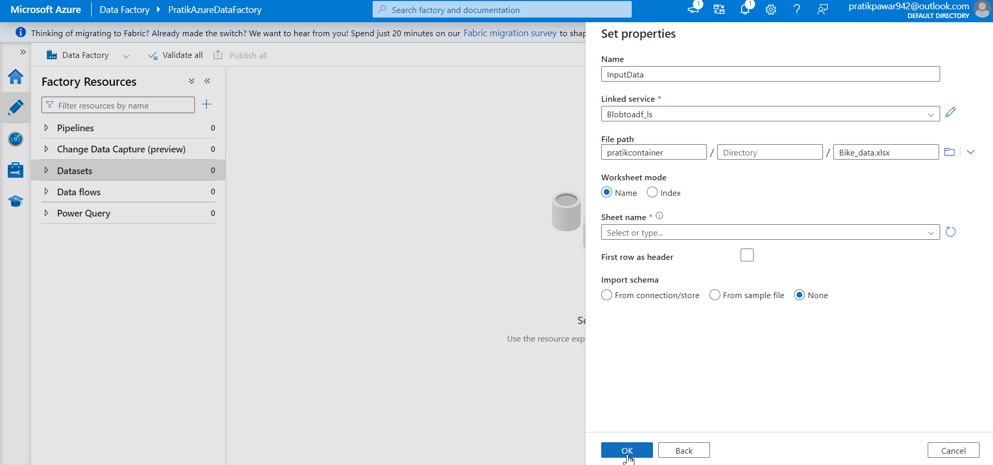
Ok

Slide 31
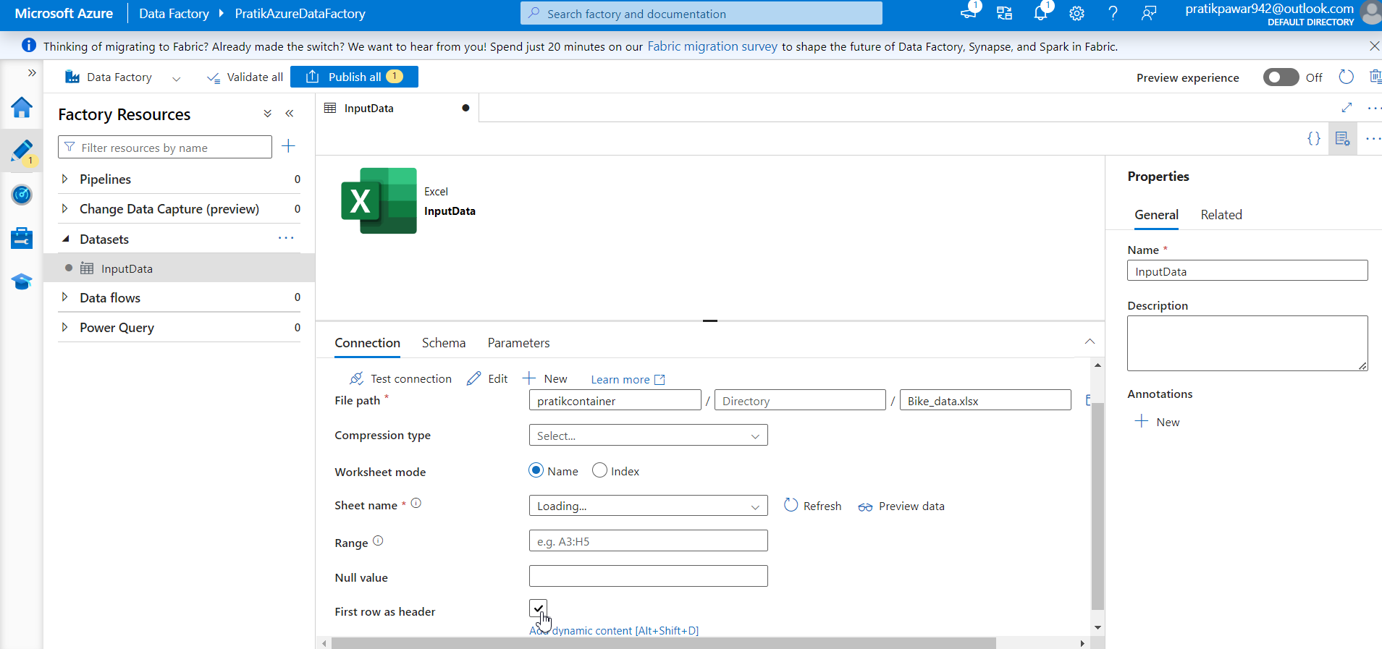
Select First Row as Header:

Slide 32
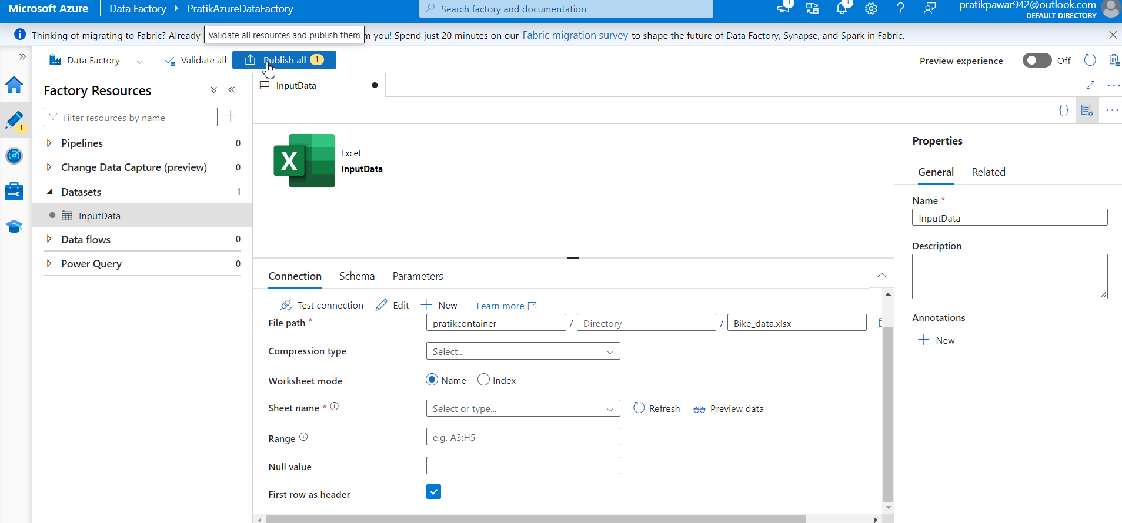
Publish all it to save to ADF → Publish (If not Publish we can lose the Data)

Slide 33
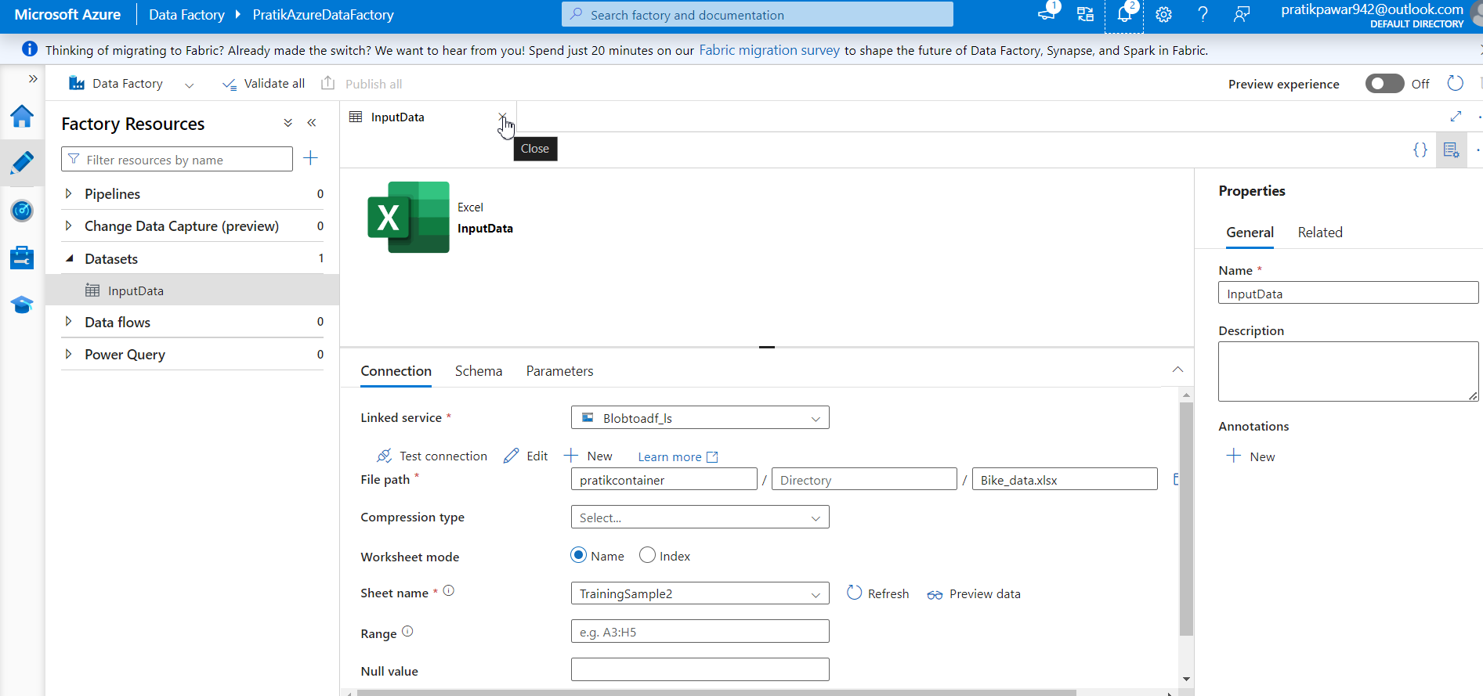
Close (Remember Datasets is like temp Storage in ADF)

Slide 34
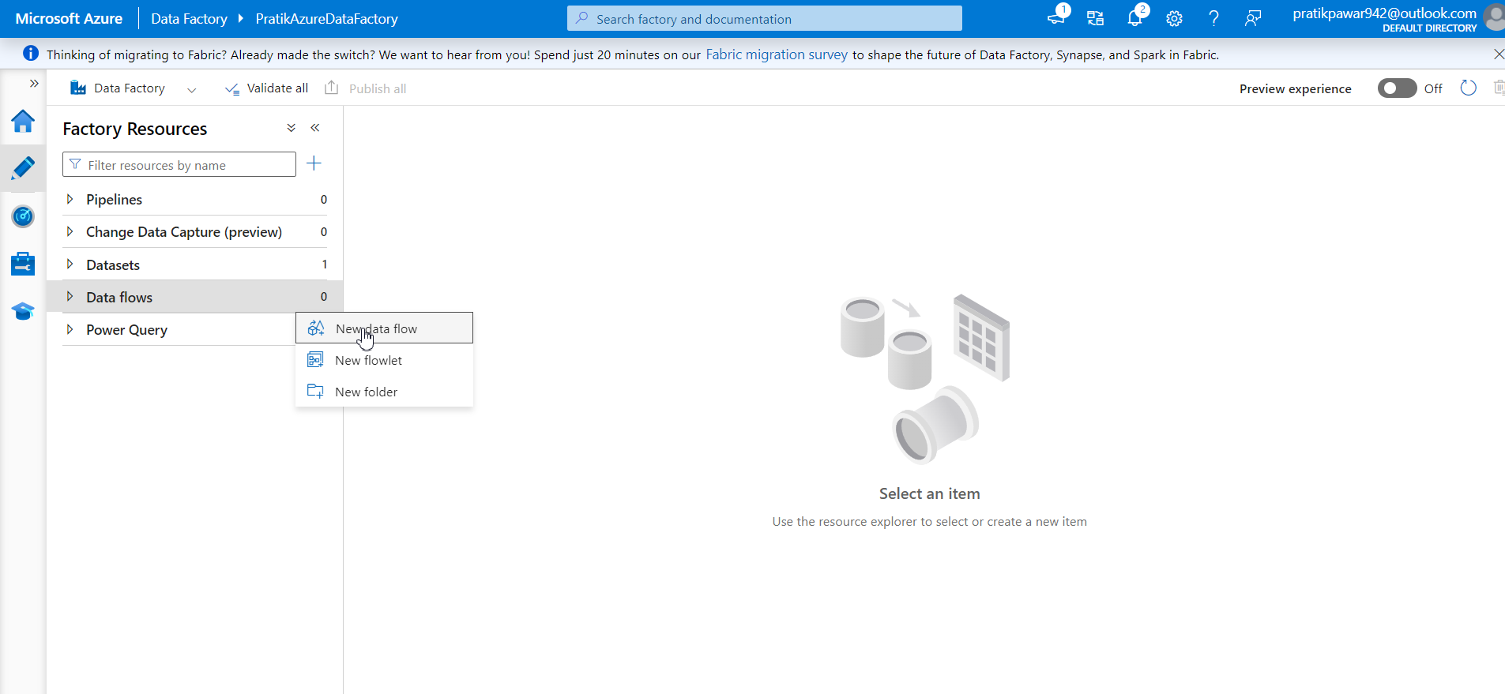
To Transform Data Go to Data Flows → New data flow

Slide 35
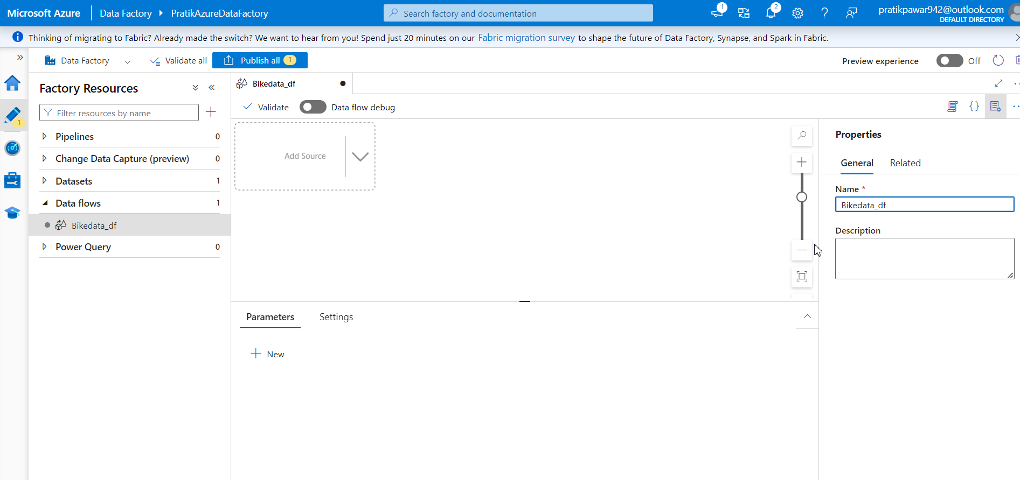
Give Name to data flow (Bikedata_df) df = dataflow

Slide 36
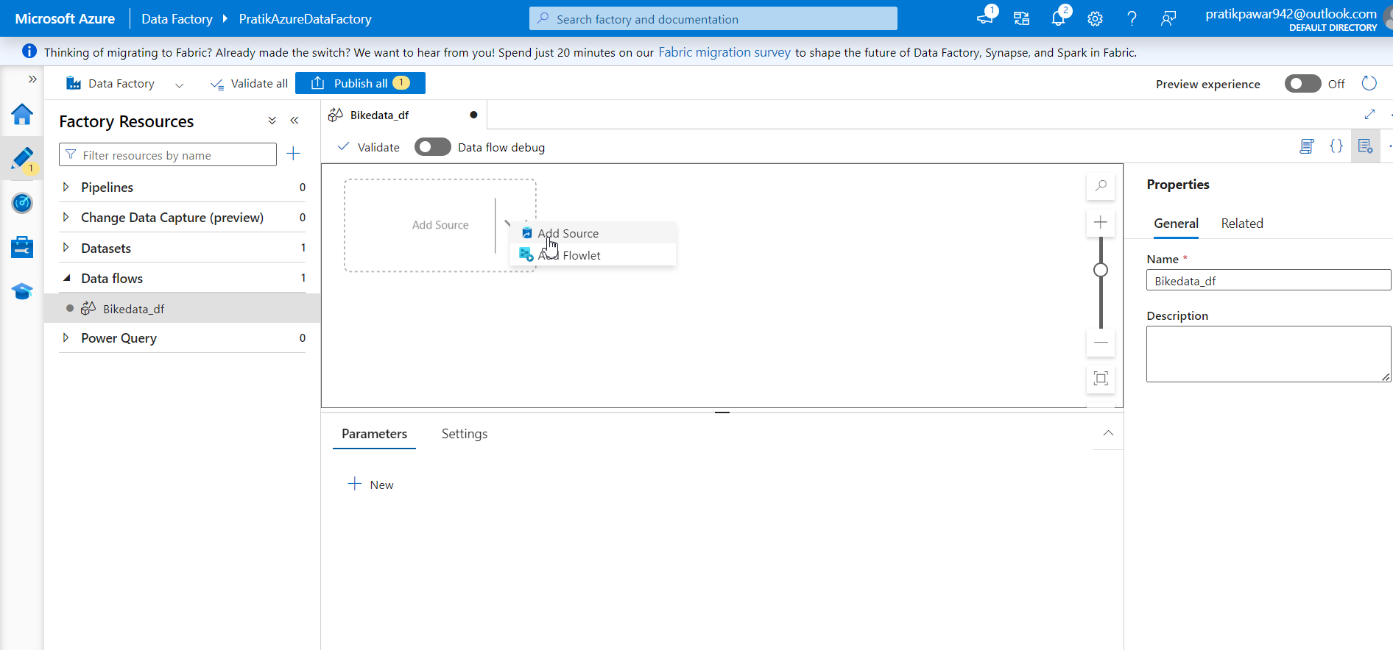
Add Source:

Slide 37
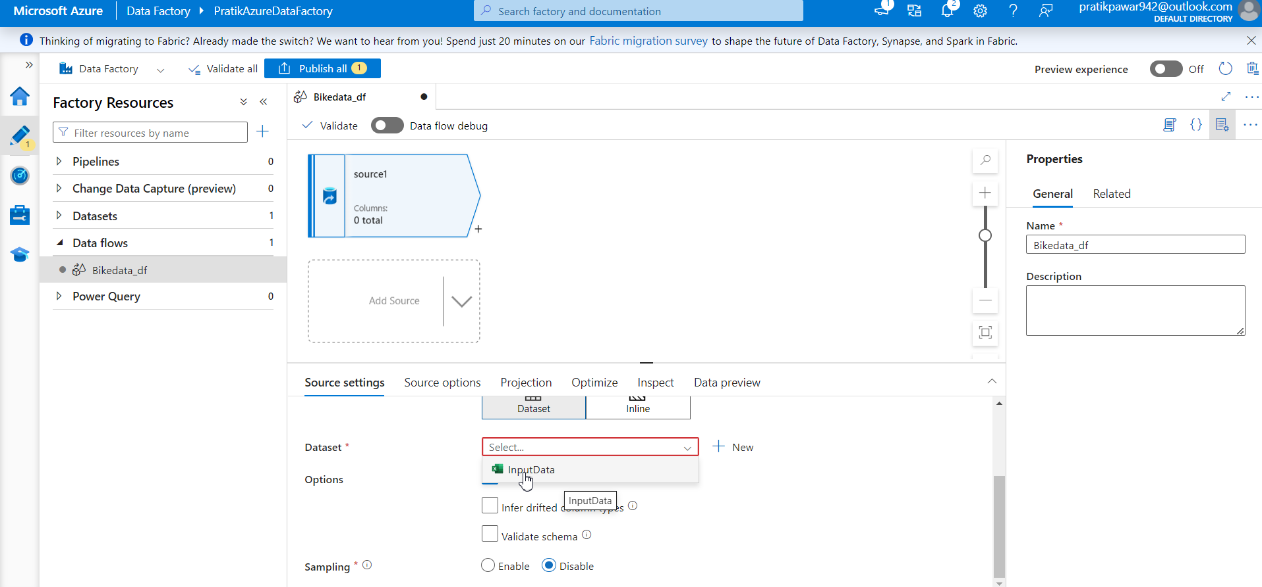
Select Raw Data which we imported ( InputData)

Slide 38
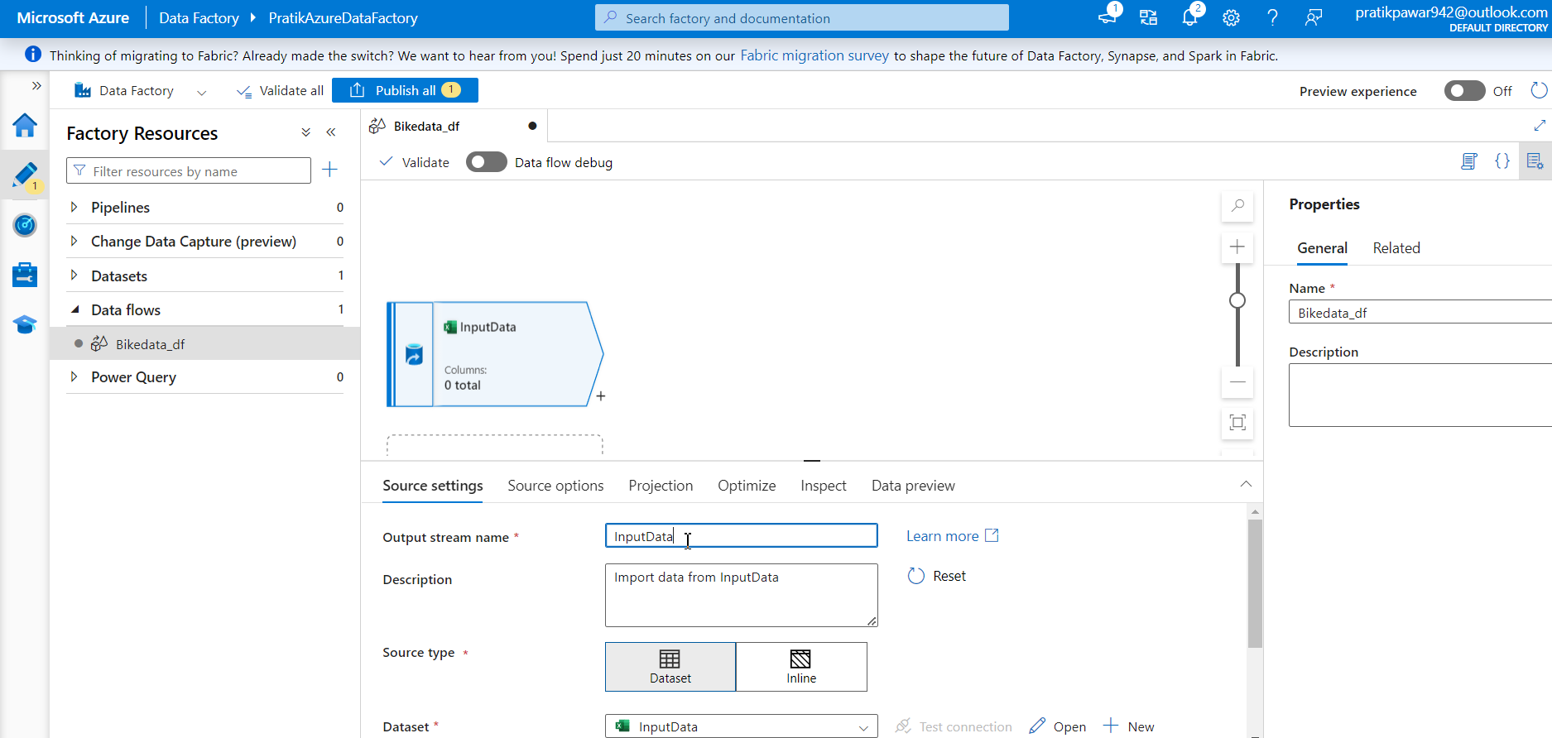
Give Name to Raw Data:

Slide 39
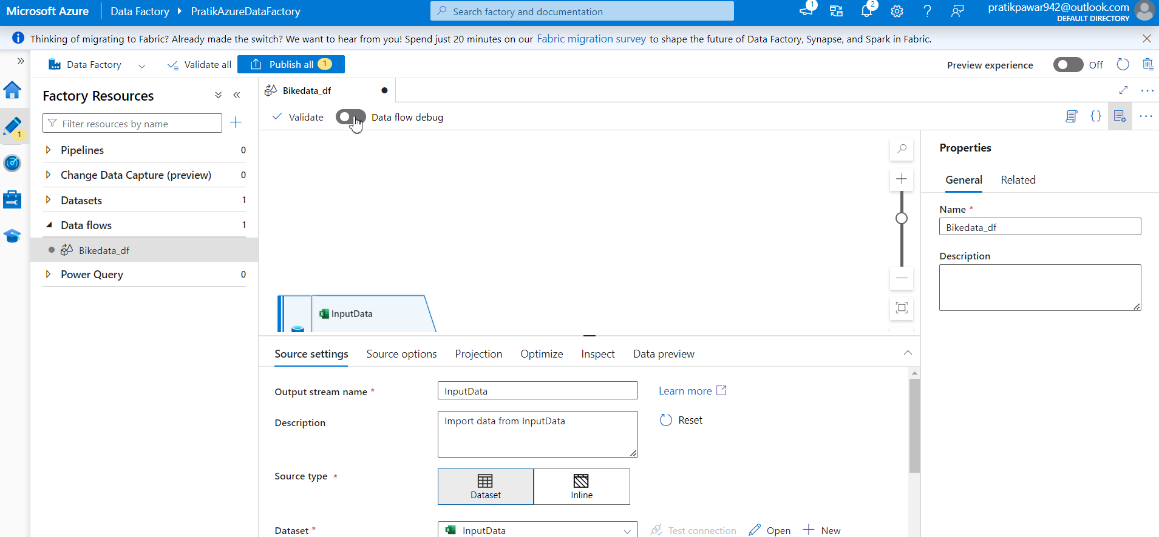
Switch On Debug Mode: (To make Changes in Data Flow)

Slide 40
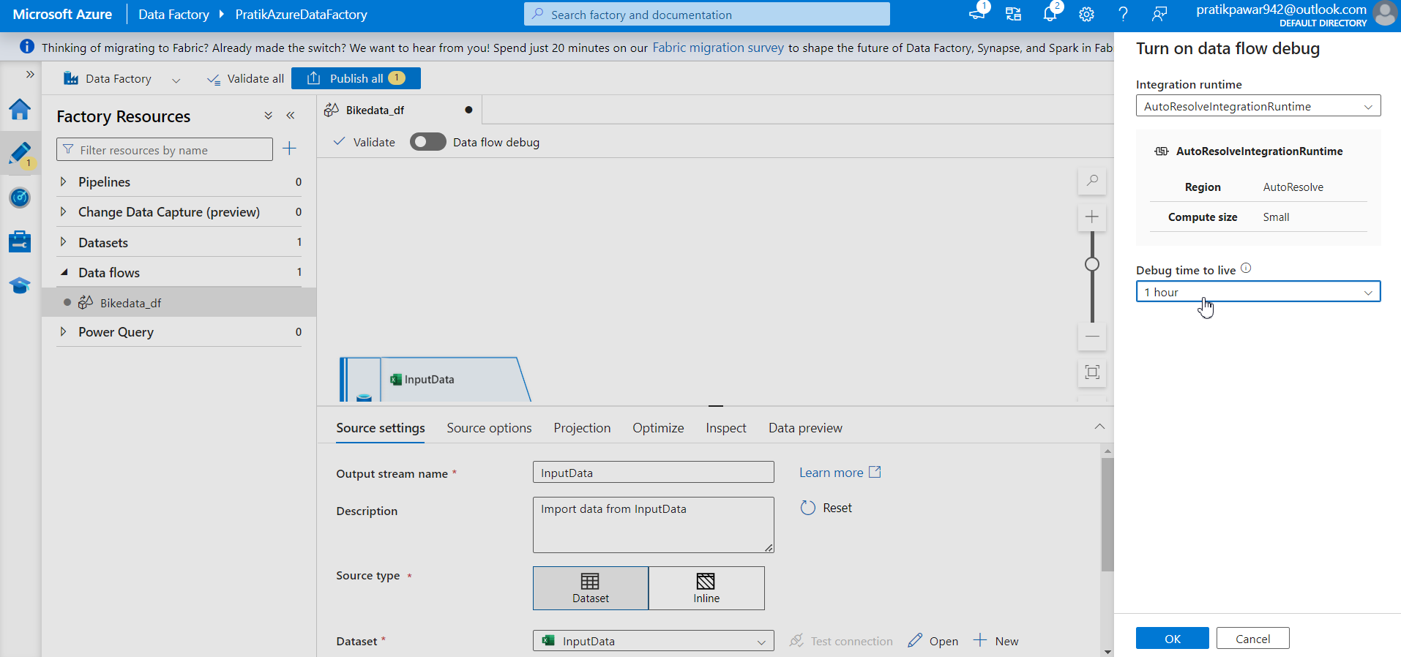
Select time According to Need ( More Hours More Charges)

Slide 41
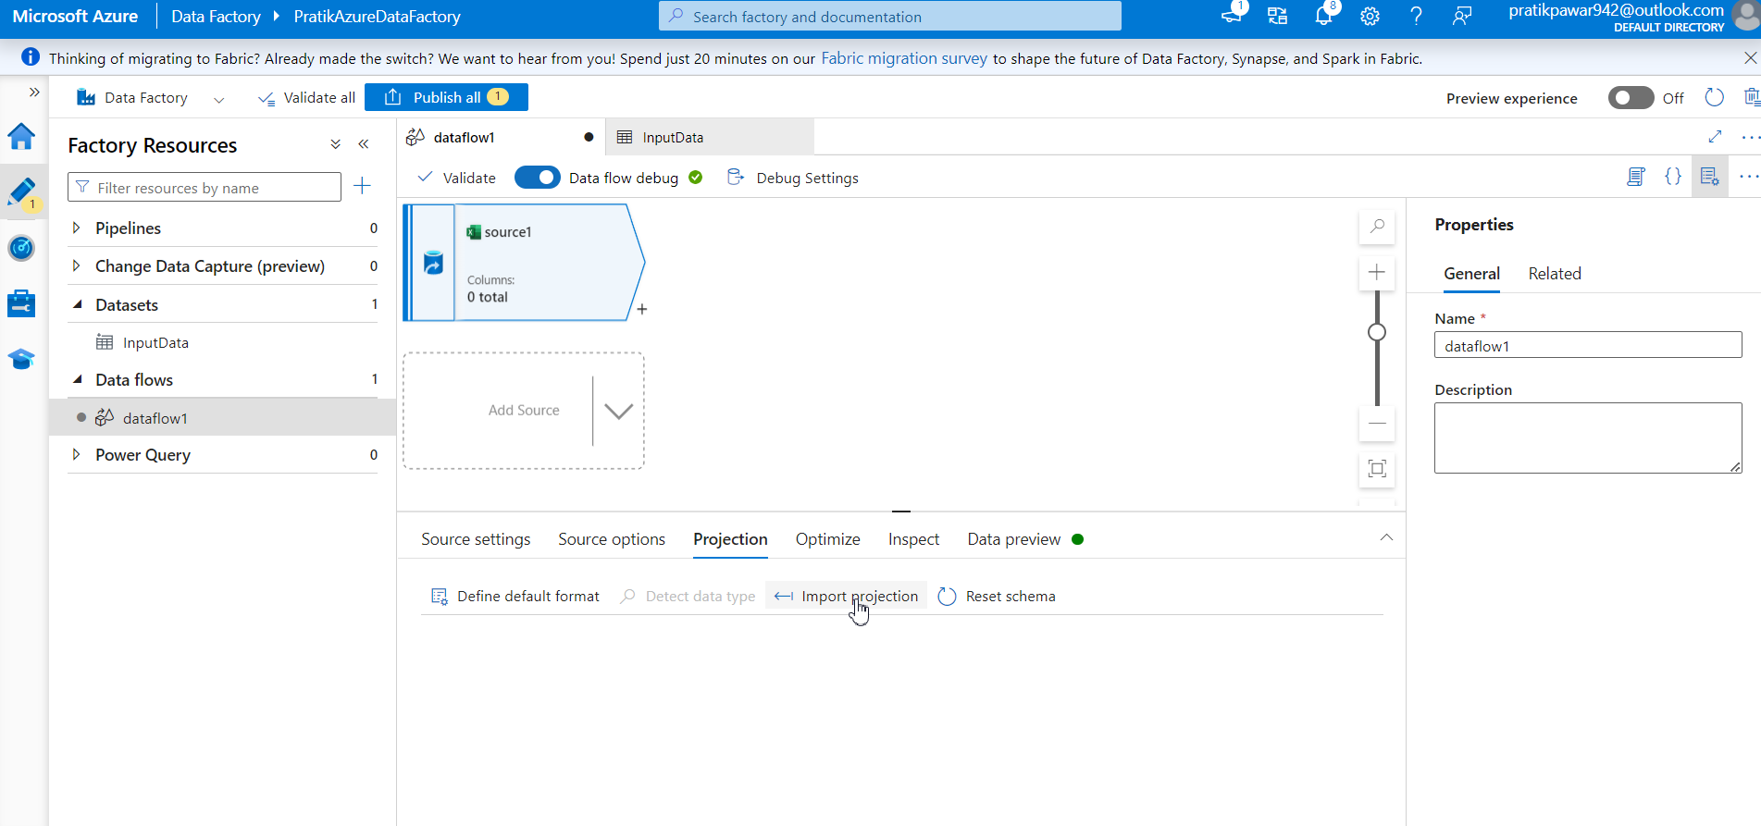
Projection → Import Projection

Slide 42
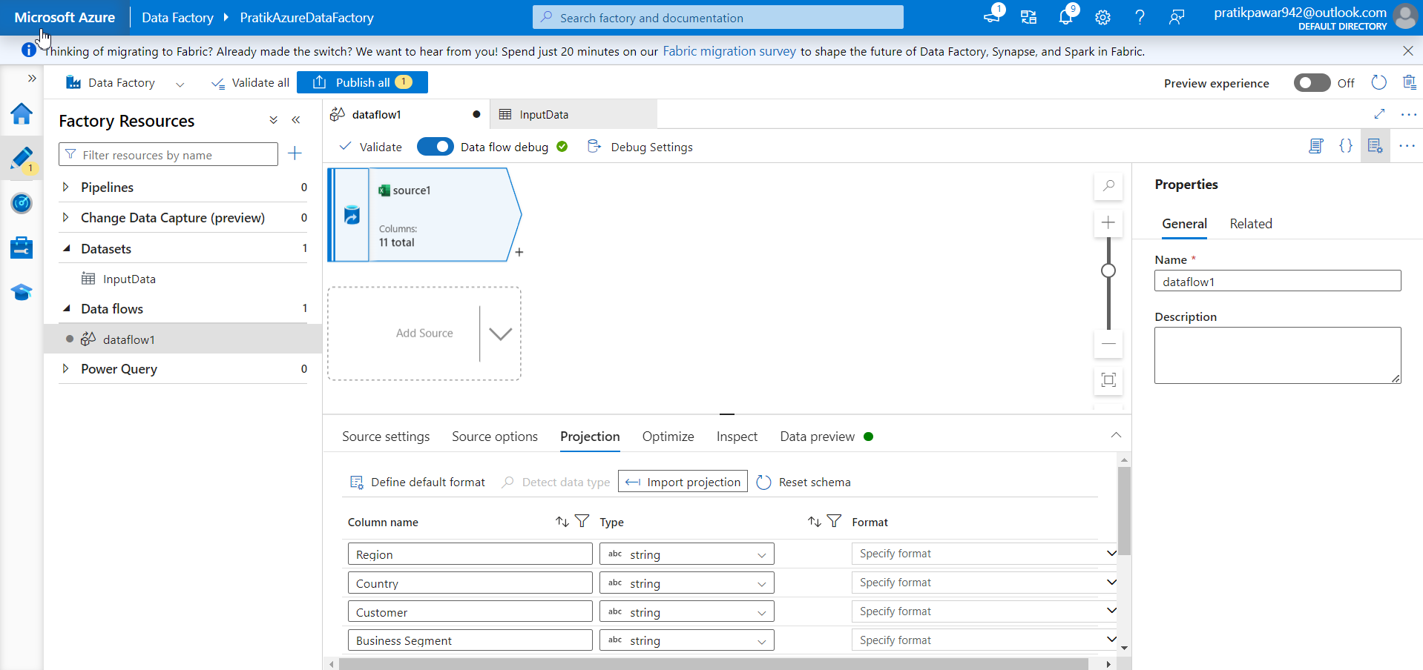
Projections: scans data gives columns name and its type (Do it always whether data is correct or not)

Slide 43
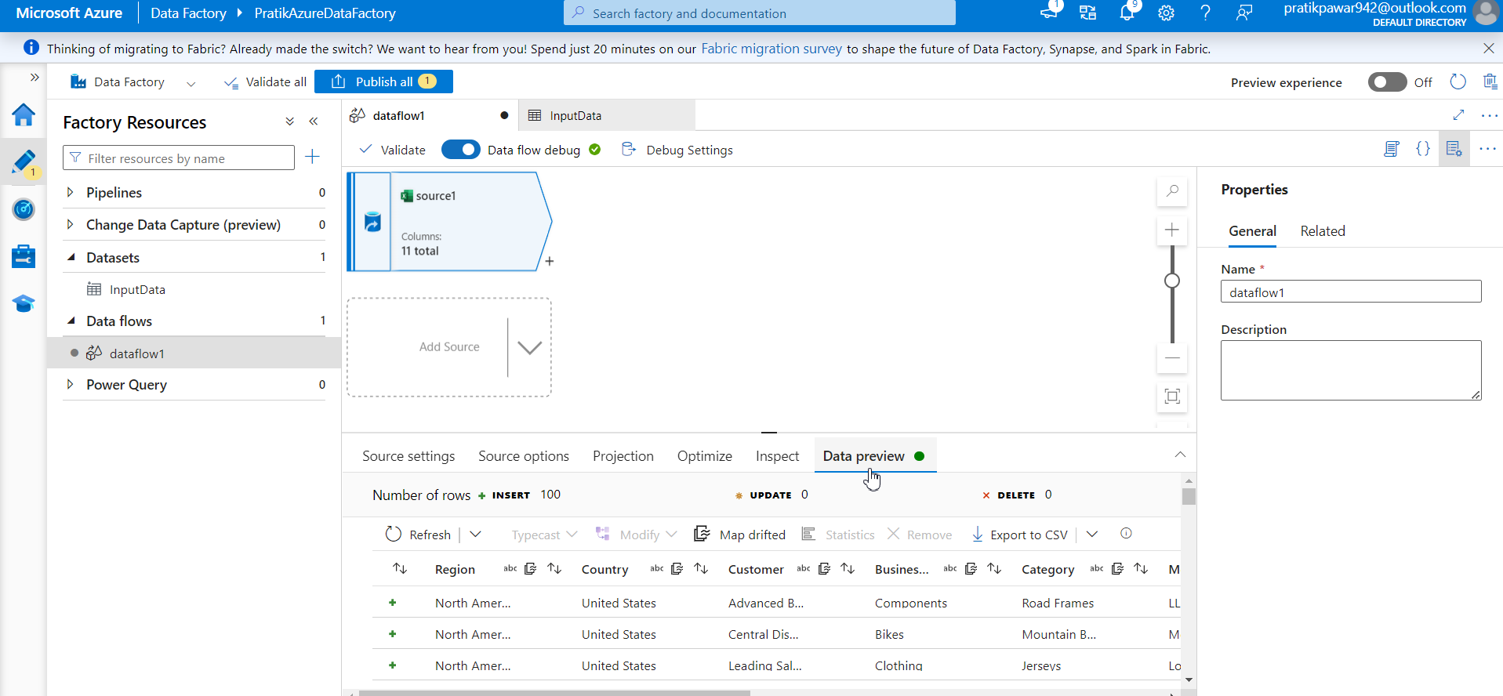
Go to Data Preview to see data:

Slide 44
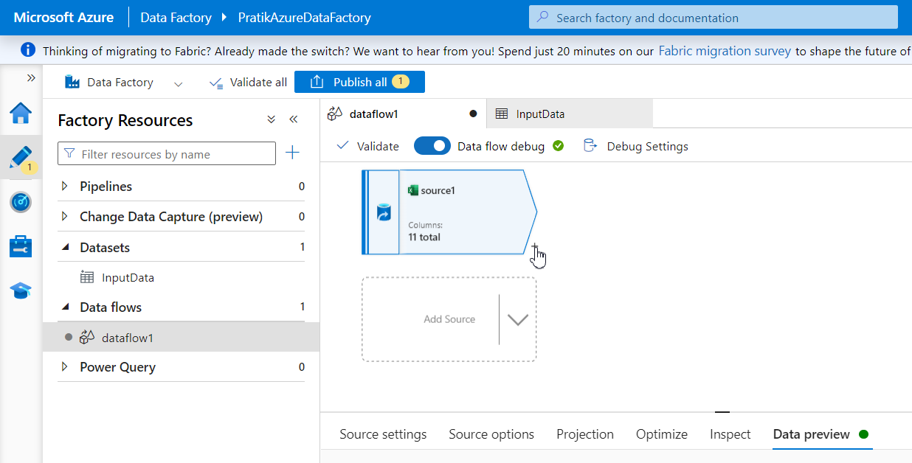
Now we are going to add new columns ‘Cost’ and ‘Sales’ so go to Plus Mark:

Slide 45
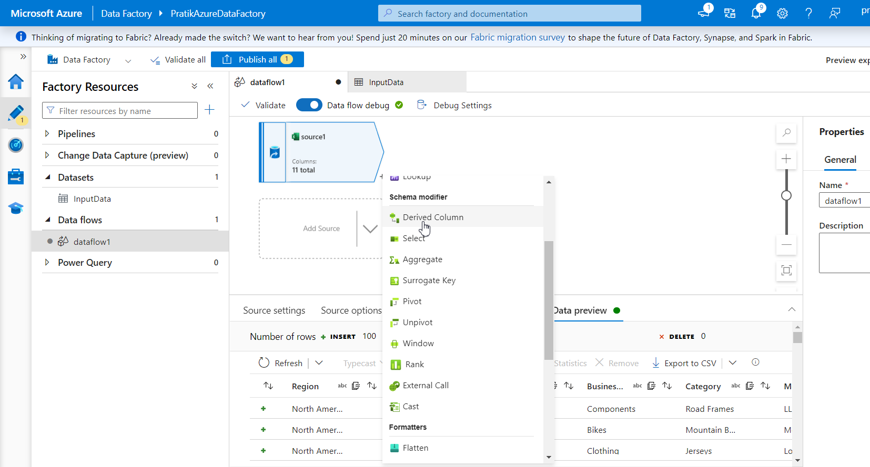
Derived Column to add New Column

Slide 46
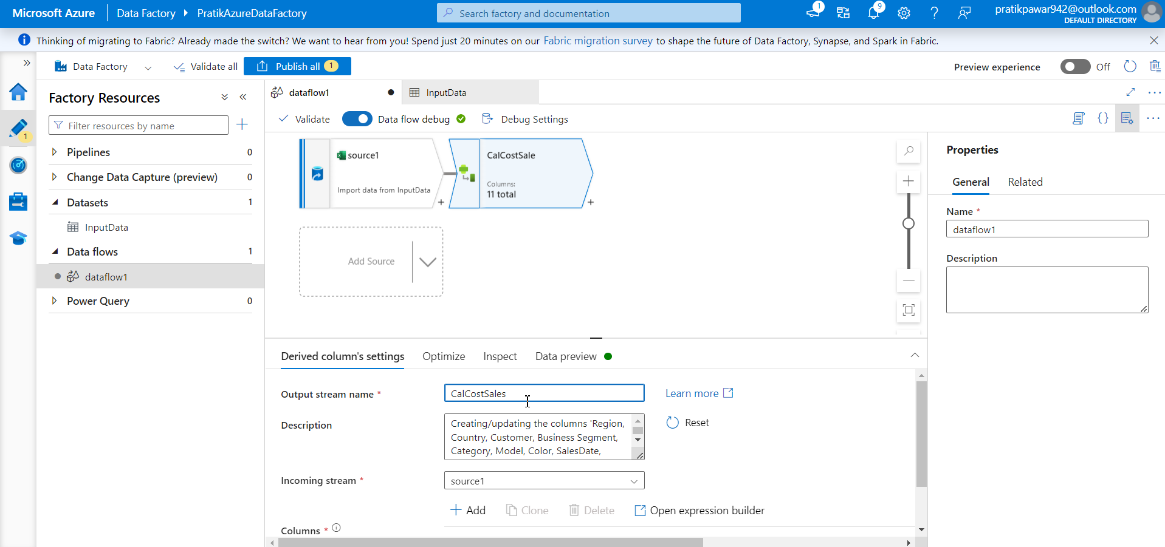
Give name to it : CalCostSales

Slide 47
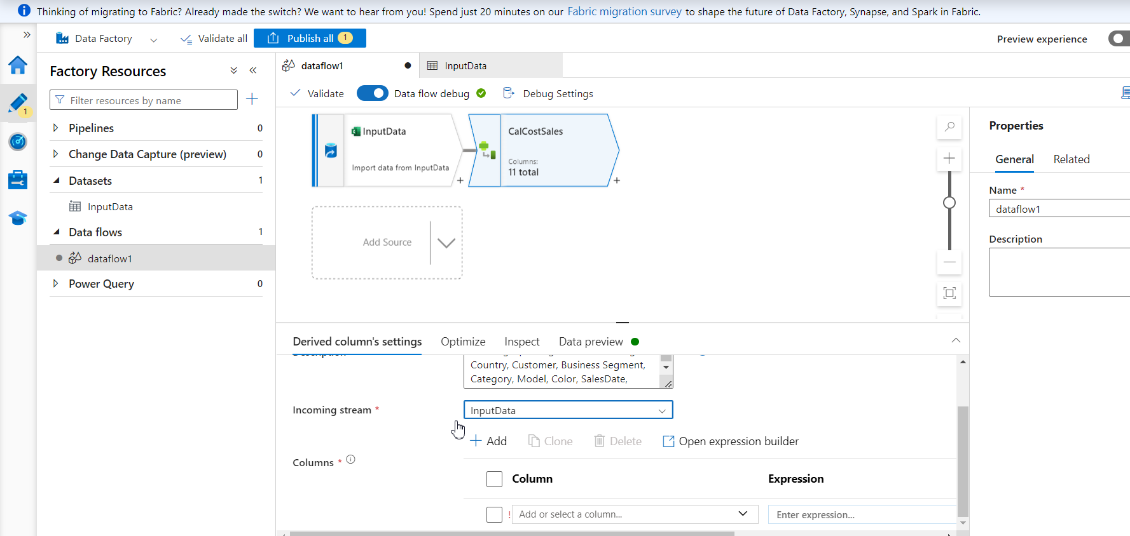
Incoming stream : InputData (Check always)

Slide 48
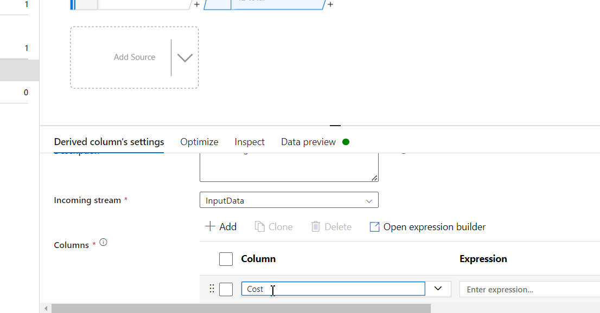
New Column Name

Slide 49
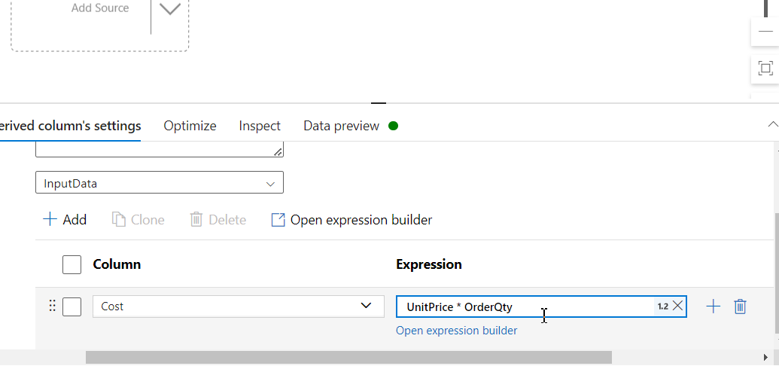
Give Expression by Multiplying two column names:

Slide 50
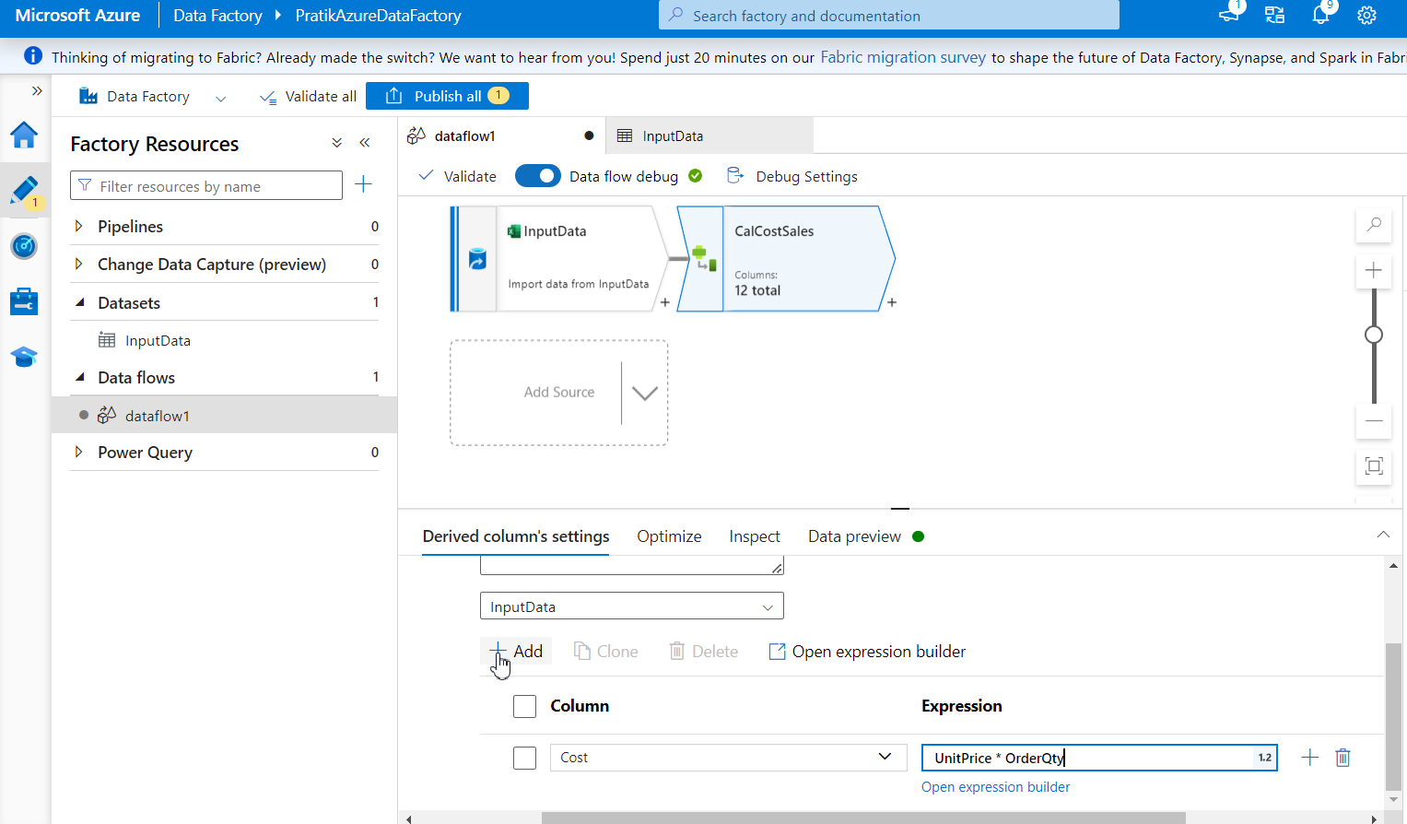
To add Another Column:

Slide 51
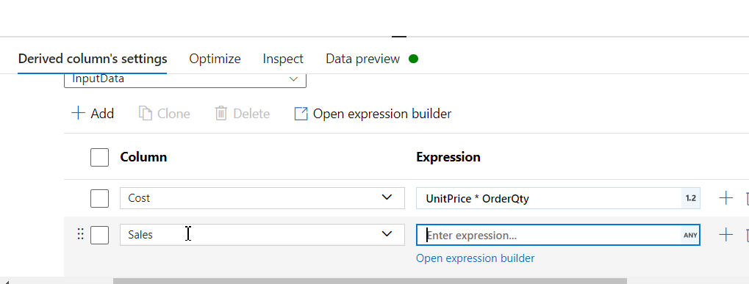
Add Another Column ‘Sales’:

Slide 52
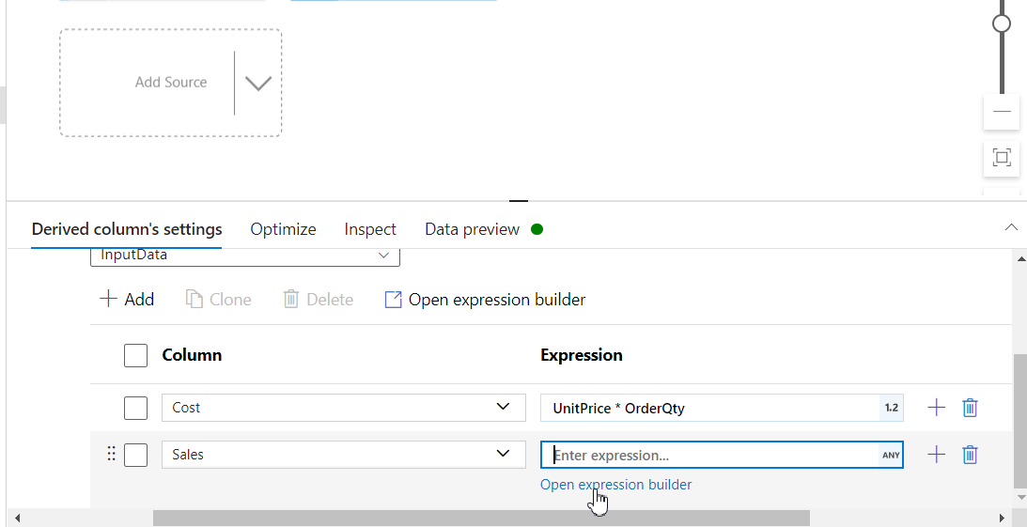
We can also go with Expression builder if we don’t know column names: ( Don’t Give space while writing Expression)

Slide 53

Select Column Name:

Slide 54

Select operation:

Slide 55

ListPrice*OrderQty

Slide 56

Now go to data Preview to check whether New Columns are added or not:

Slide 57

In order to calculate profit we need sales – cost but we cant add it in ‘CalCostSales’ instead we have to create new Dervied Column to perform operation

Slide 58

Give Name - CalProfit

Slide 59

New Column Name – Profit and Open Expression Builder

Slide 60

Sales-Cost → Save and finish

Slide 61

Go to Data Preview to see the New Profit column is added or not:

Slide 62

Now to delete columns which is not Required , go to + → Select

Slide 63

Give name – DeleteColumns

Slide 64

Delete Not Required Columns

Slide 65

Check Data Preview whether columns are deleted or not:

Slide 66

Now our Transformation is over. To End it we have to sink the pipeline

Slide 67

Give name to sink

Slide 68

Now we have to store data in another datasets so we have to linked we other database i.e SQL database Go to NEW

Slide 69

Choose Azure SQL database and Continue

Slide 70

Give name as OutputData as it output

Slide 71

Linked Service → New

Slide 72

Give name to linked Service – ADFtoSQLDatabase_ls

Slide 73

Select ServerName, Subscription and Database name

Slide 74

Give user name and password for authentication which was created during creation of SQL database

Slide 75

Test Connection

Slide 76

Create

Slide 77

Create NEW TABLE as we are opening first time Data.

Slide 78

Now give name Bike_Data_Tb and ok

Slide 79

Now publish the work so to save the work till now

Slide 80

Publish

Slide 81

Remember we just connect SQL database to ADF now we have to trigger pipeline to go data to SQL Database

Slide 82

Now create new pipeline to execute dataflow from ADF to SQL Database

Slide 83

Give name BikeData_pl (pl= pipeline)

Slide 84

Go to move and Transform

Slide 85

Pick Data flow and through into blank space

Slide 86

Now go to setting and select dataflow which we have created

Slide 87

Now publish it to save it

Slide 88

Now go to add trigger and trigger now to run the pipeline so cleaned data will push into SQL database

Slide 89

Ok (we can also schedule pipeline)

Slide 90

Monitor → Pipeline runs

Slide 91

Now pipeline ran successfully now check in SQL database cleaned data

Slide 92

SQL database → Refresh

Slide 93

Tables → Bike_data_Tb

Slide 94

Now run SQL Query to see data

